Slide 1
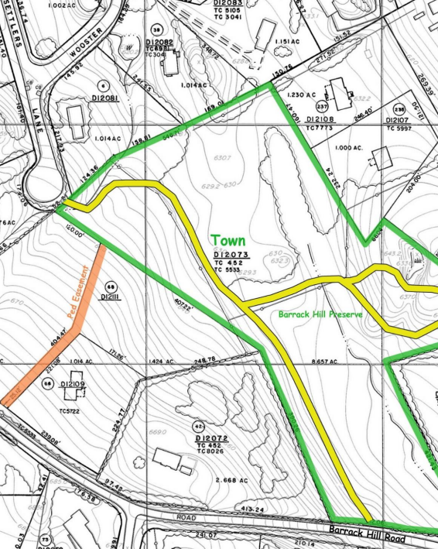
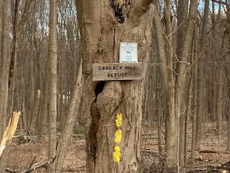
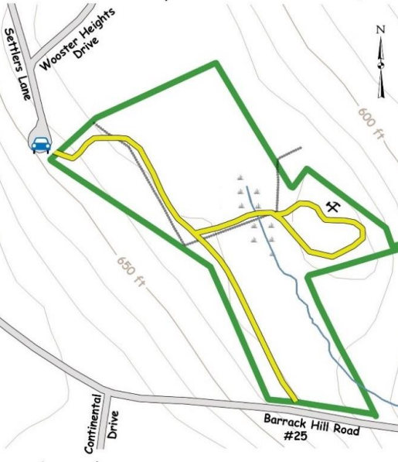
Ridgefield Conservation Commission
Barrack Hill Refuge - Eagle Project Completion
By Alec Rogers

Slide 2
Completed Project Summary
Summary of Work
On October 28th I led a group of 15 volunteers in a 9-hour project at Barrack Hill Refuge. The project involved removing an existing 20 ft bridge and replacing it with a new one. Project details included:
Removing the existing bridge in its entirety, which included over thirty 4-ft treads, two 6x6 footings, two 6x6 joists and two sections of 2x4 tread covers. Nails were removed from each treads.
Constructing a new bridge using 2x10 joists, 6x6 footings and 2x6 treads
Two 5-ft 6x6 footings installed on each end. The 6x6 beams were attached with 8-inch lag screws
Joist hangers used to anchor 3 sets of joists to the footings
Treads spaced ½ inch apart and anchored with 3 ½ inch galvanized deck screws. ½ inch of overhang was left on each side of the treads for a more seamless and attractive bridge appearance
Anti-slip strips installed on each tread using 1 ¼ inch galvanized deck screws
Cleared some fallen trees and debris from the bridge site for safety, accessibility and aesthetic purposes
Section of the trail just beyond the bridge was cleared of debris
Project Benefits
New bridge provides a safer and more attractive stream crossing
Constructed of new treated lumber and galvanized screws for a much longer life
Greater durability through the use of three support joists (two are reinforced) and shorter treads (3ft versus 4ft)
Anti-slip strips provide greater safety for visitors

Slide 3
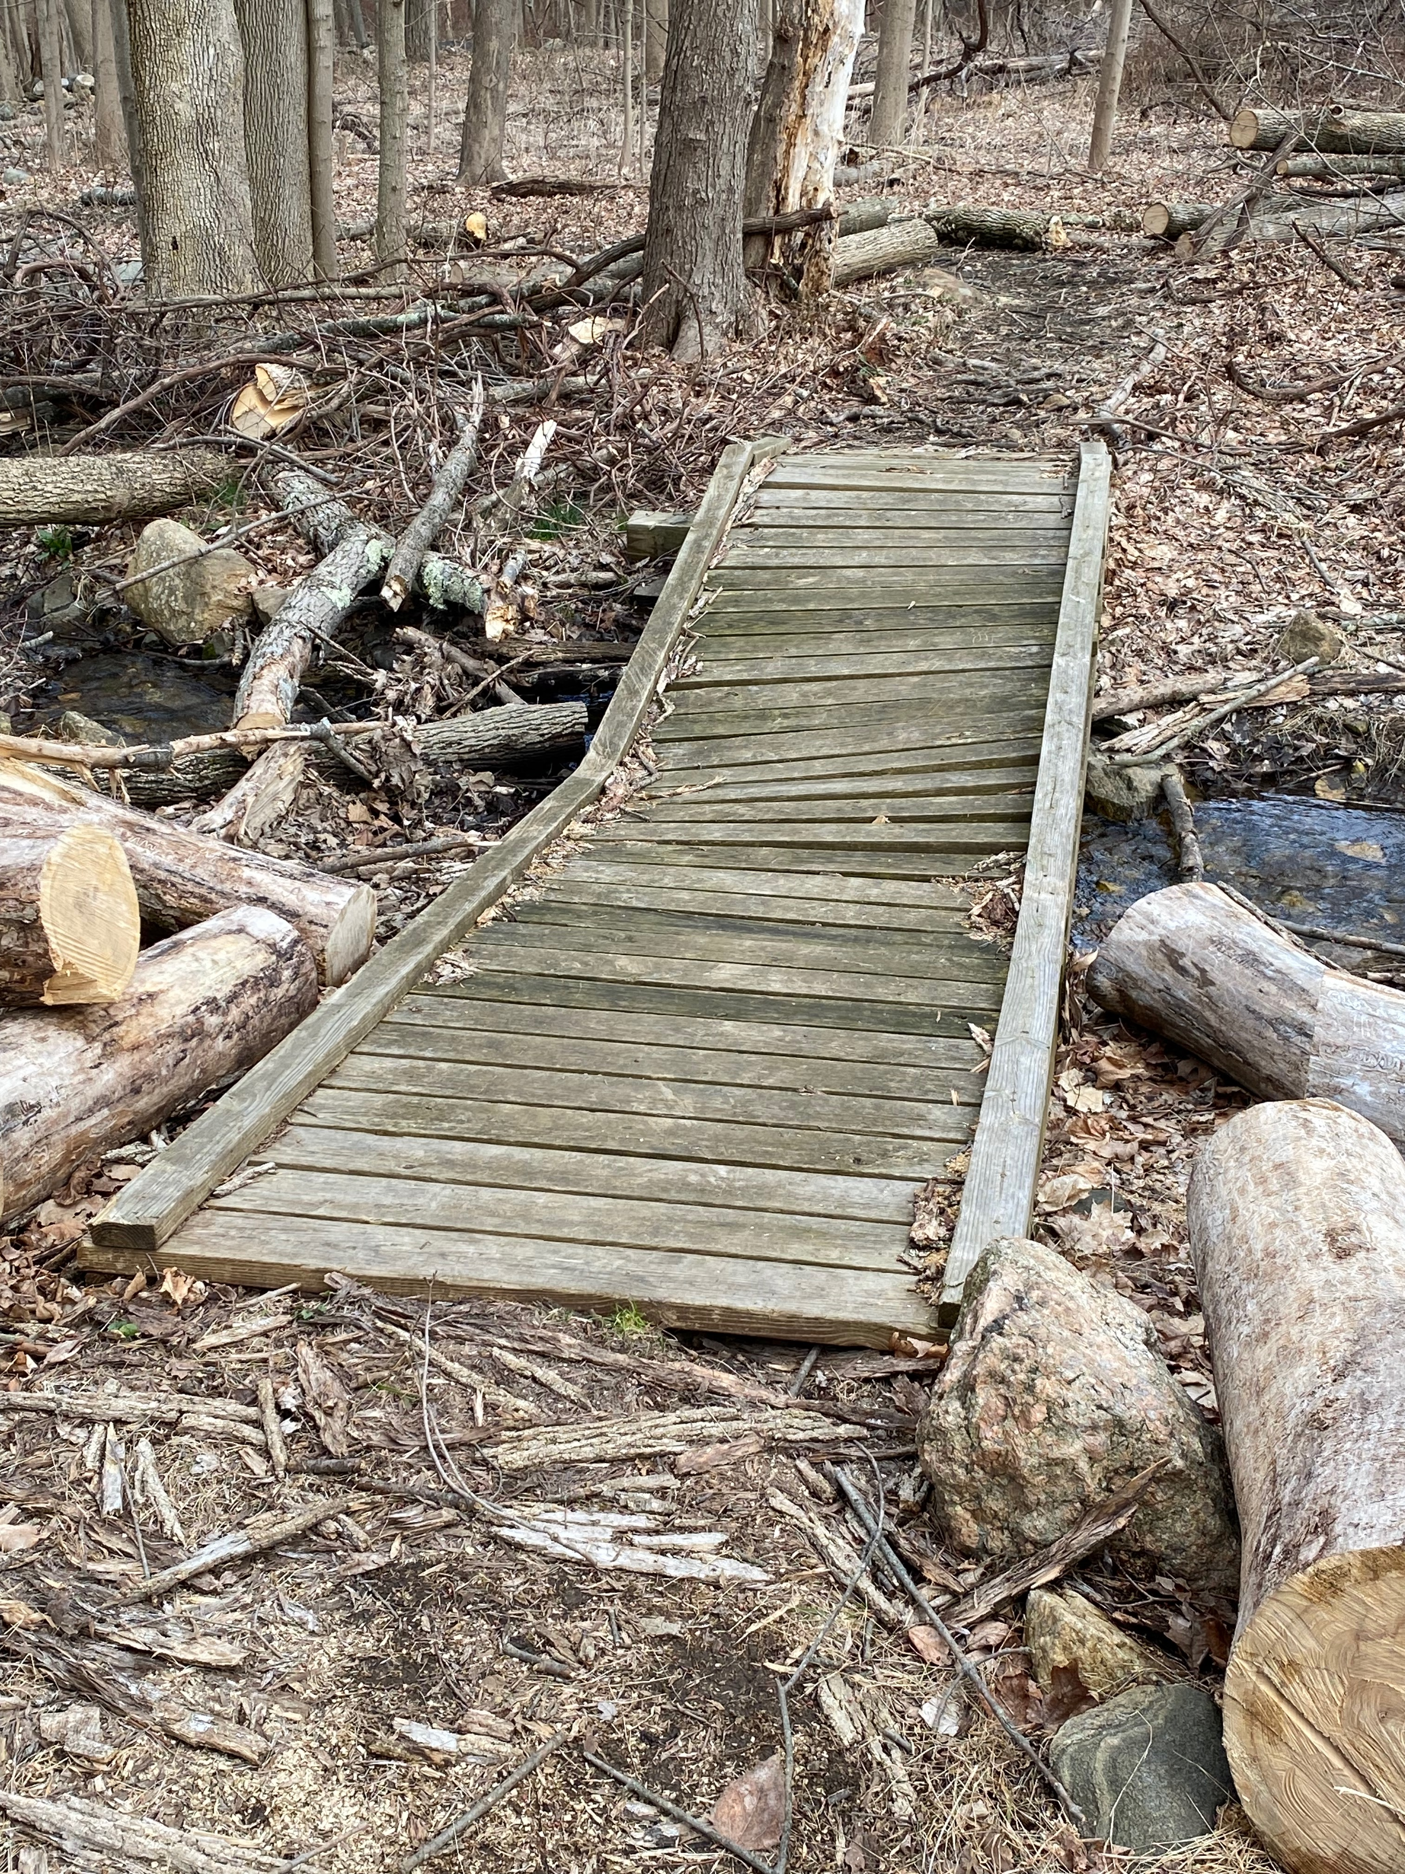
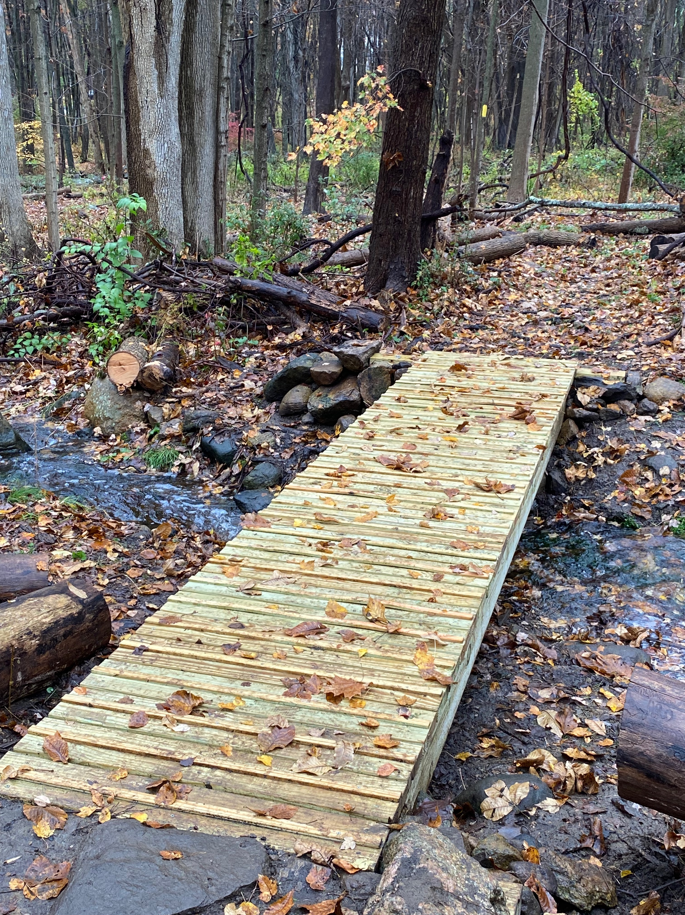
Before and After
Original Bridge
New Bridge

Slide 4
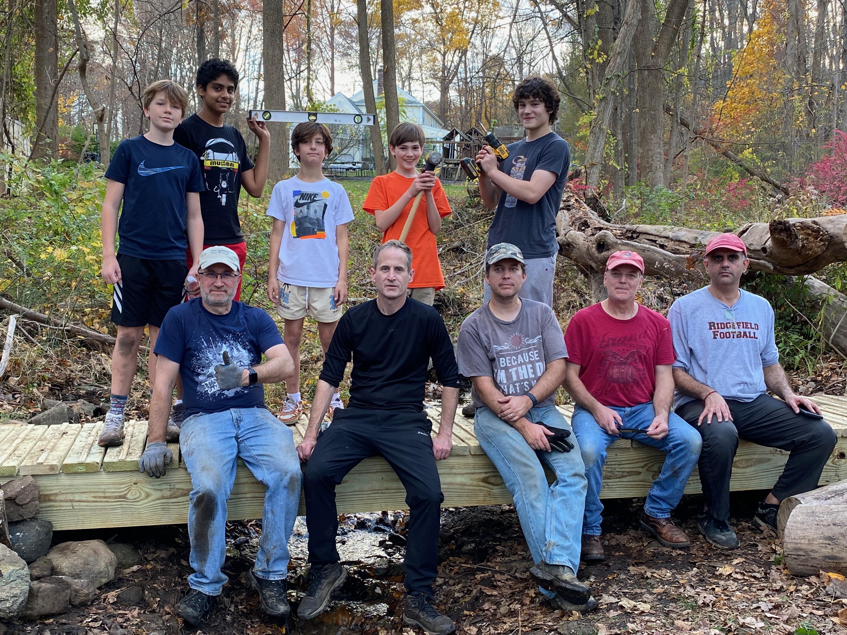
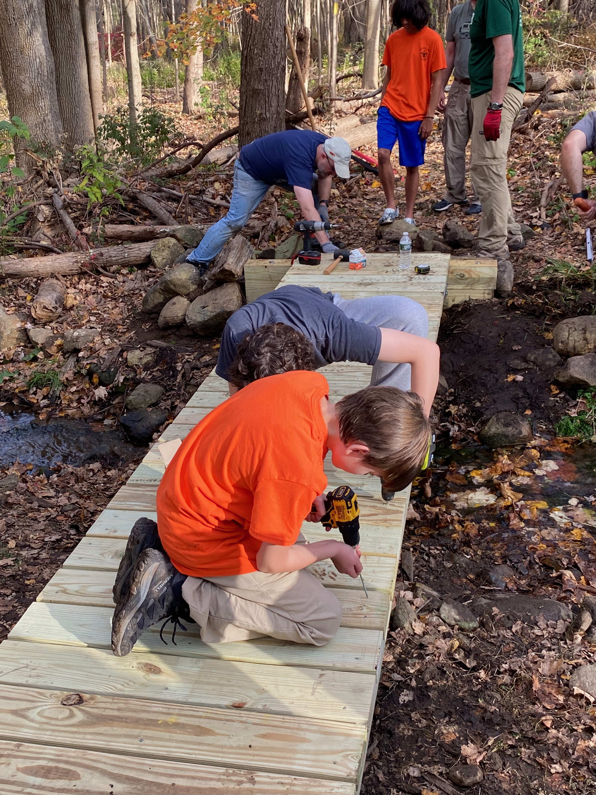
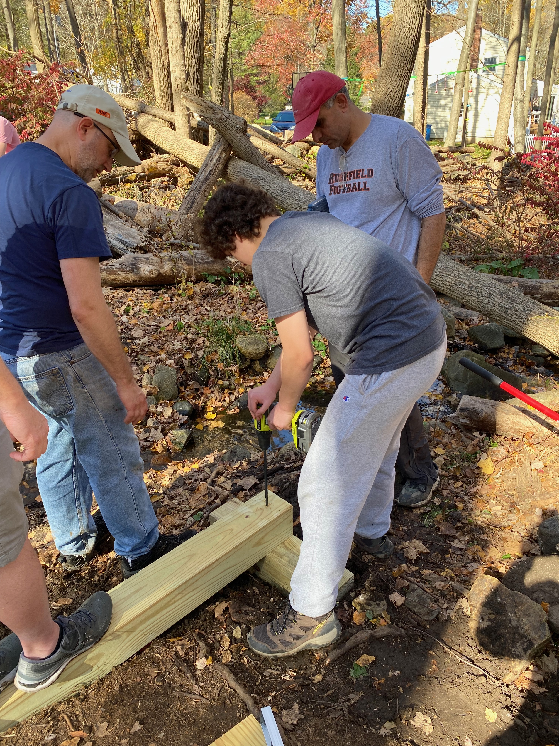
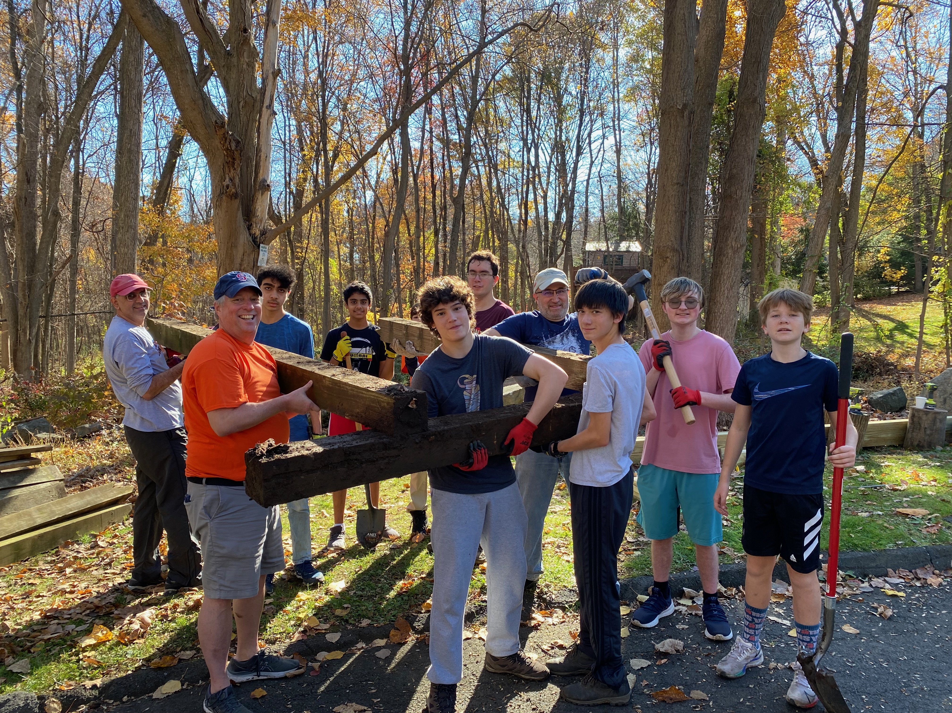
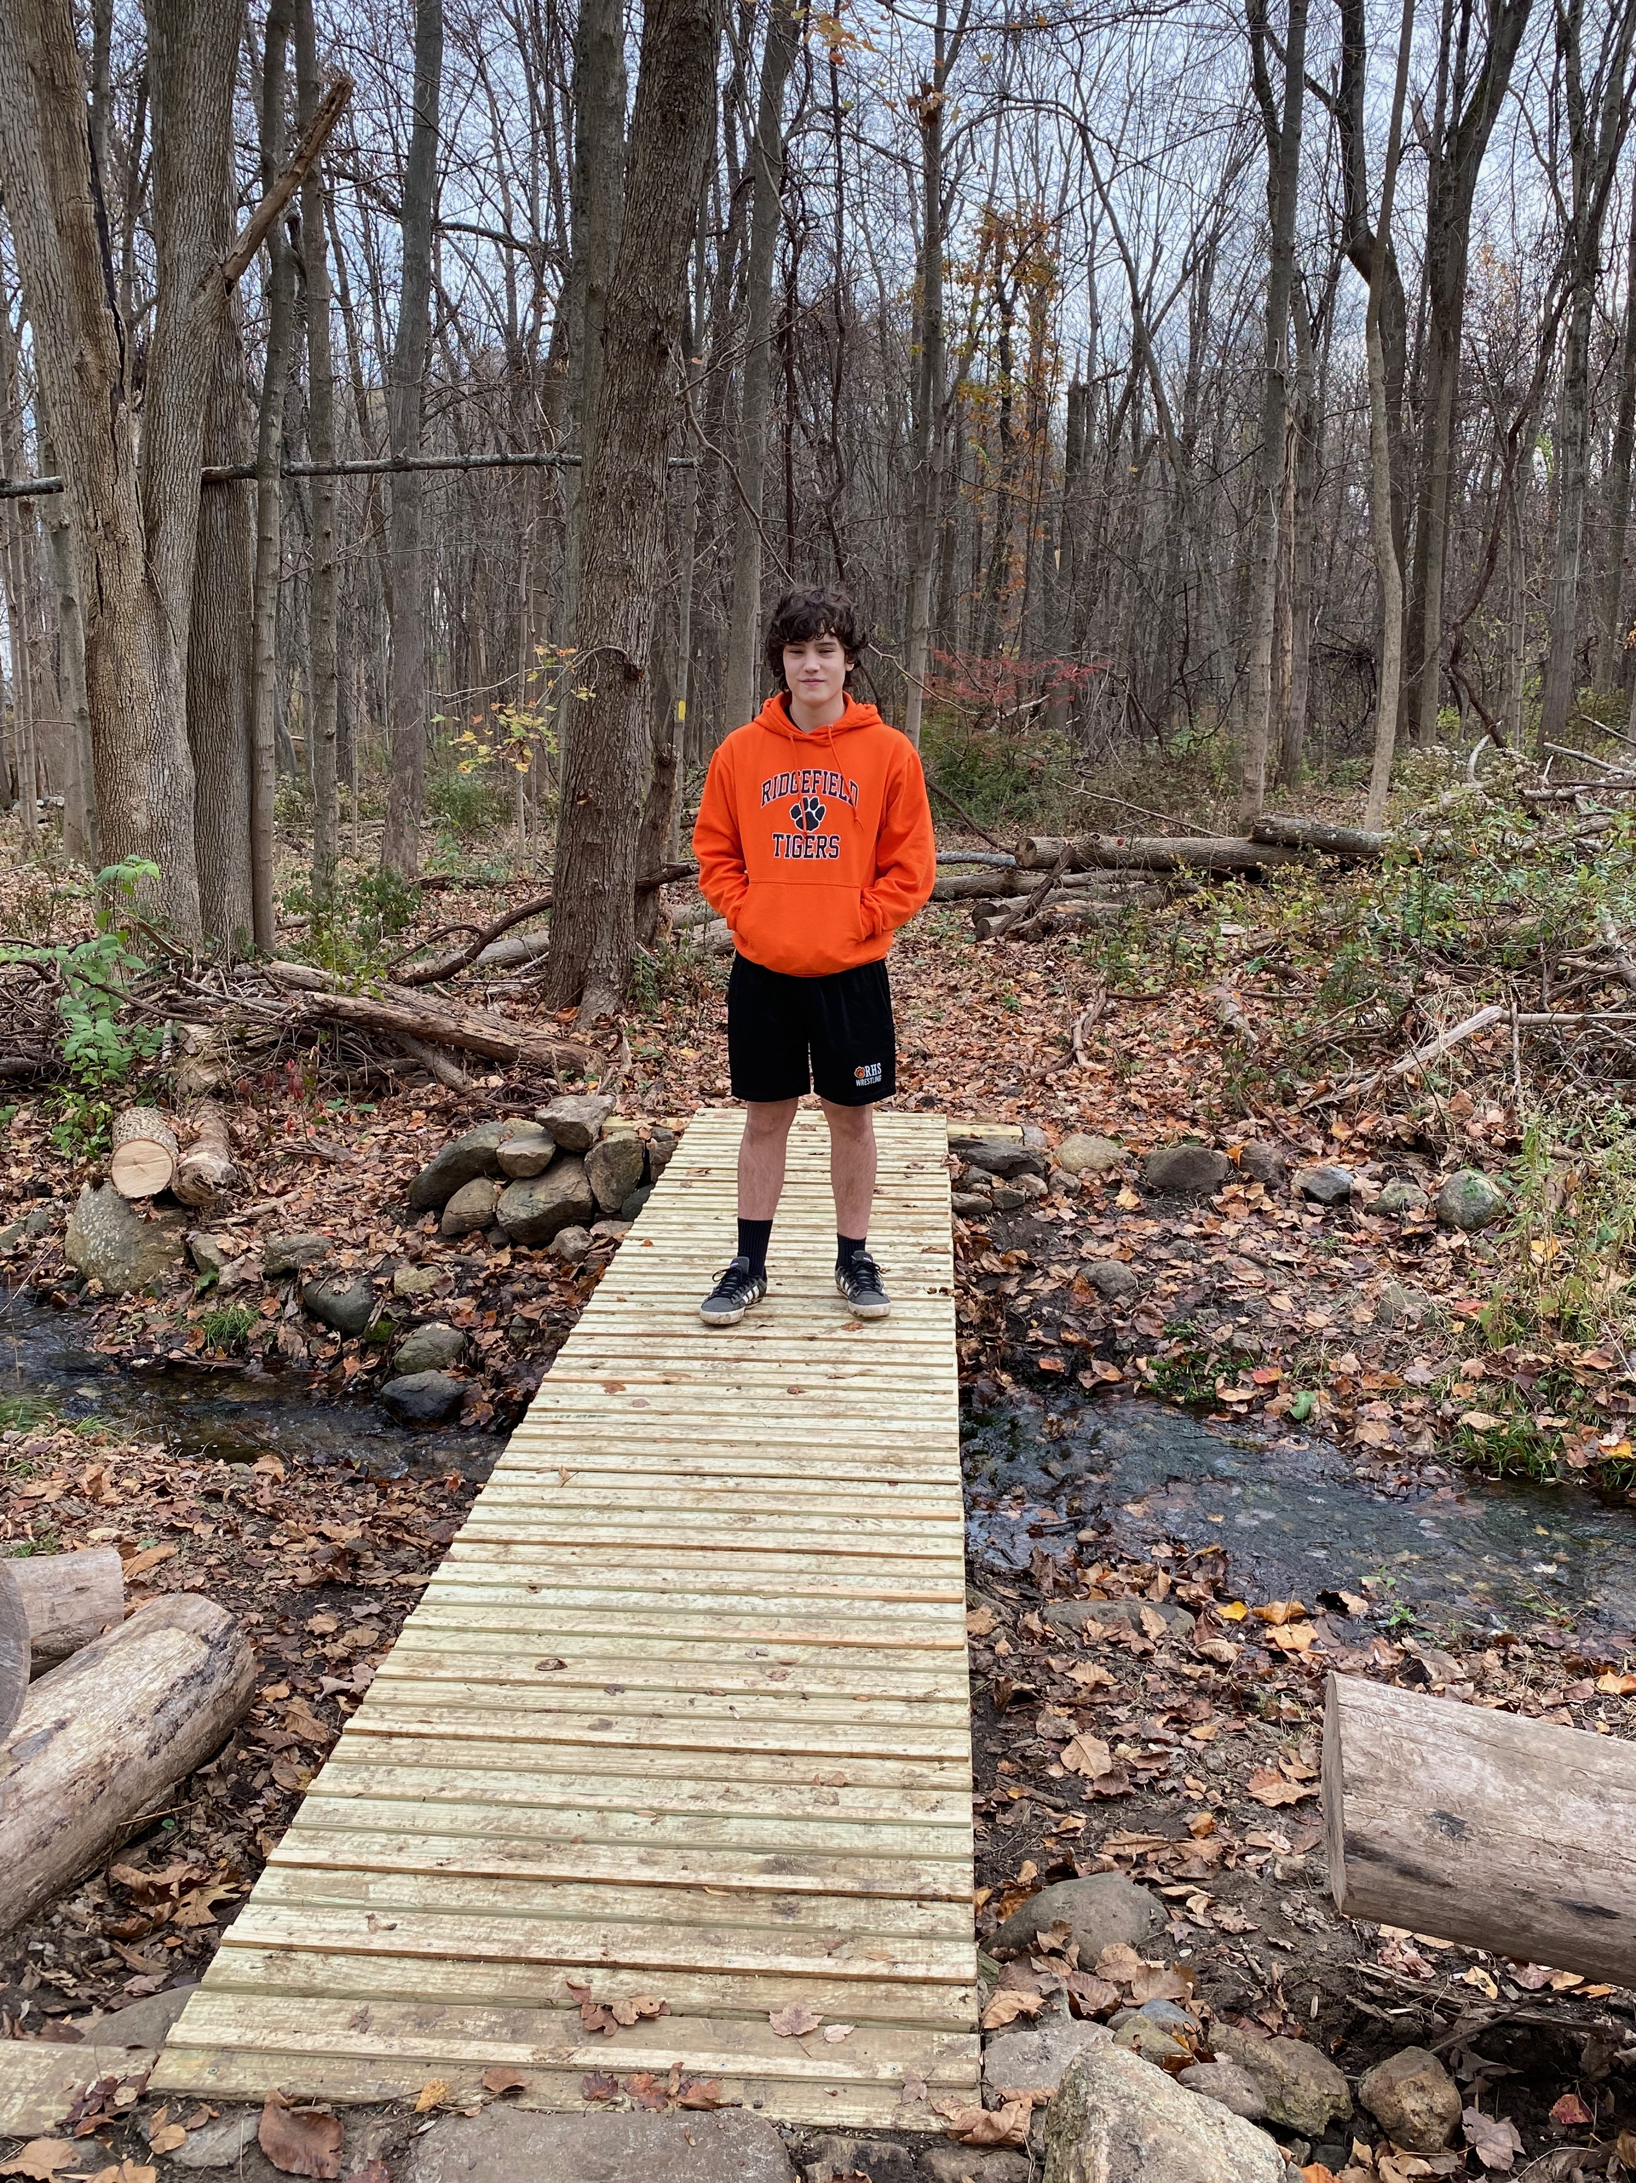
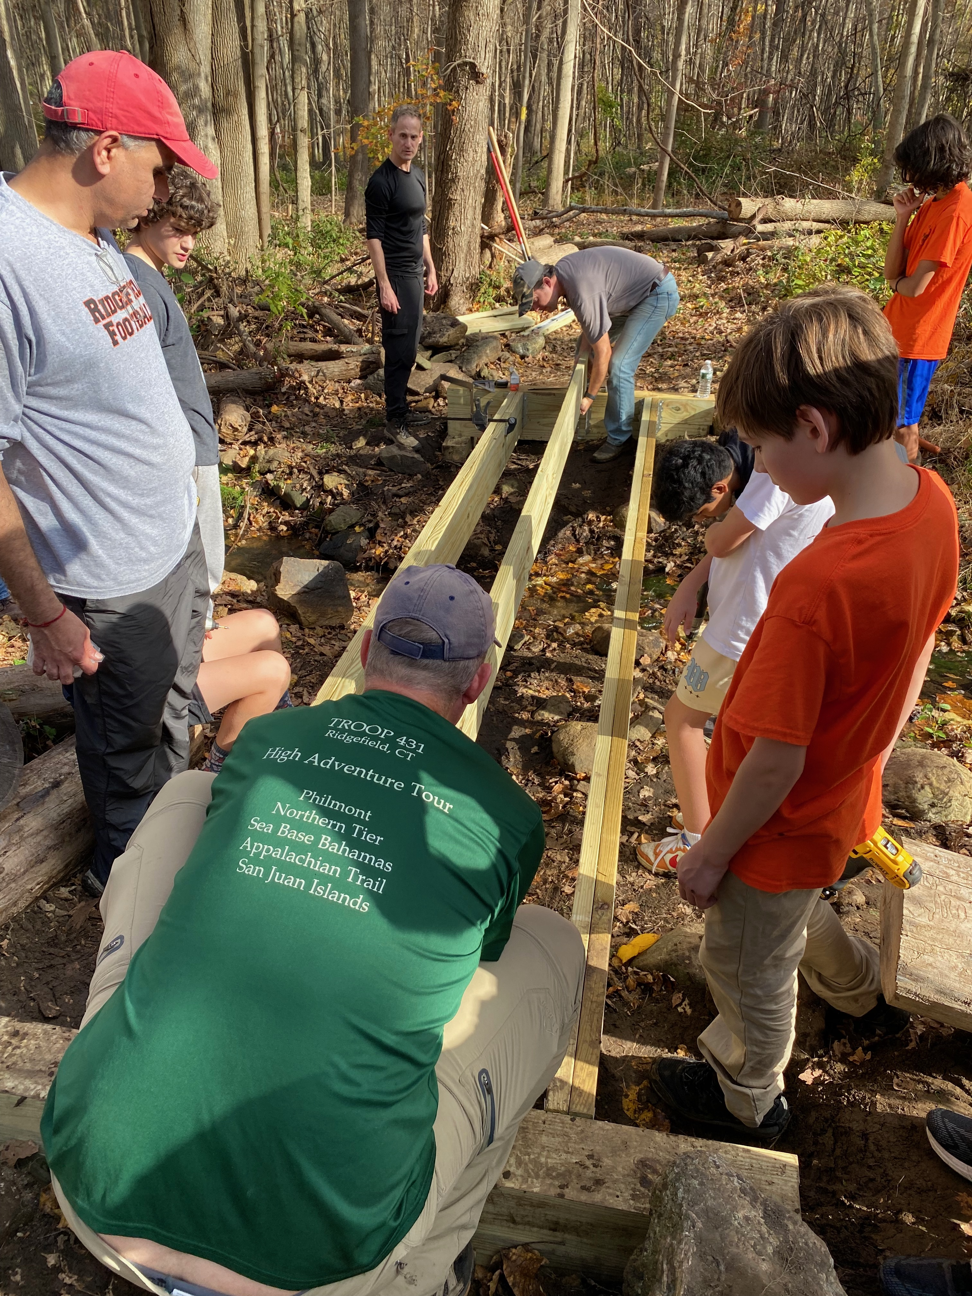
Bridge Work Day Pictures

Slide 5
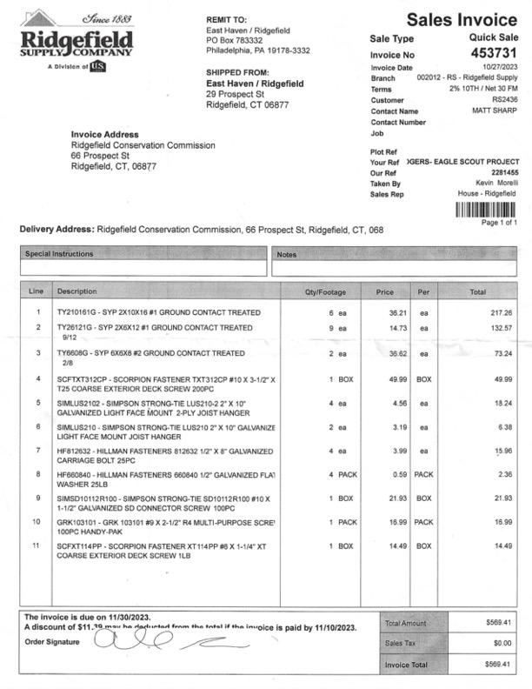
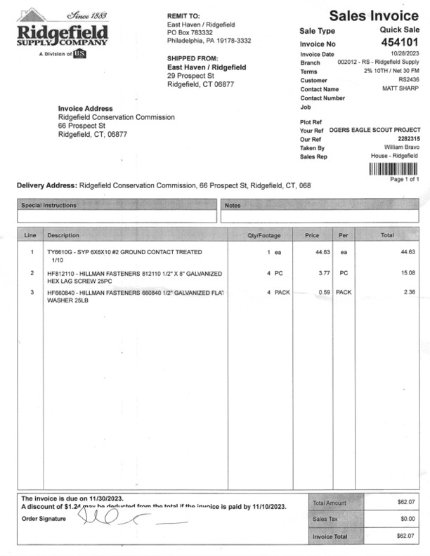
Project Costs
Total project cost was $631.48. The breakdown is below:
Lumber - $467.70
Joist Hangers - $24.62
Deck Screws & Lag Screws - $139.16

Slide 6
Closing
Thank you for your time and support!

