Slide 1
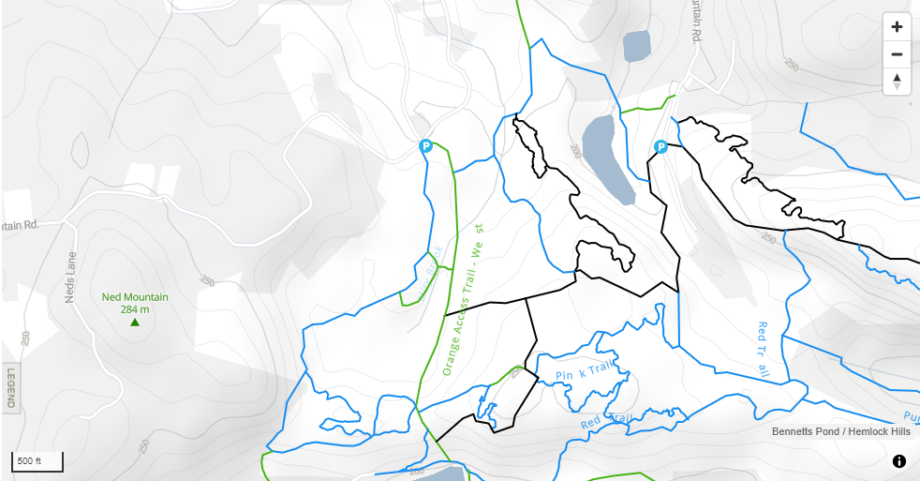
Hemlock Hills Eagle Project
Ned’s Mountain Road Parking
Jordan Mooney - Troop 19

Slide 2
Project Description
Replacing two wooden bridges on the green trail at Hemlock Hills
Constructing a 13’6” bridge
Constructing an 11’2” bridge
Disposal of old bridges

Slide 3
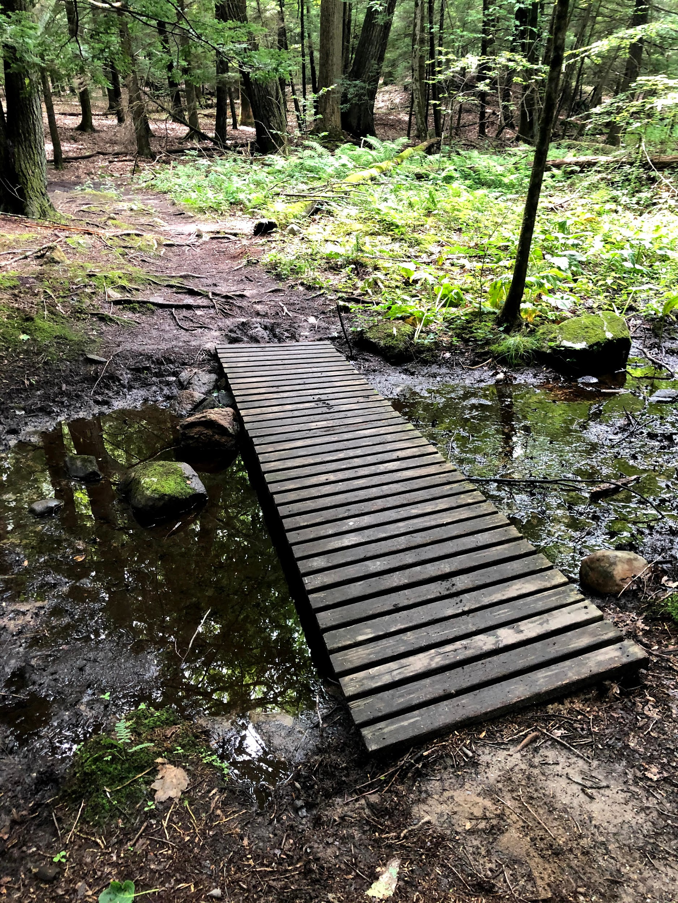
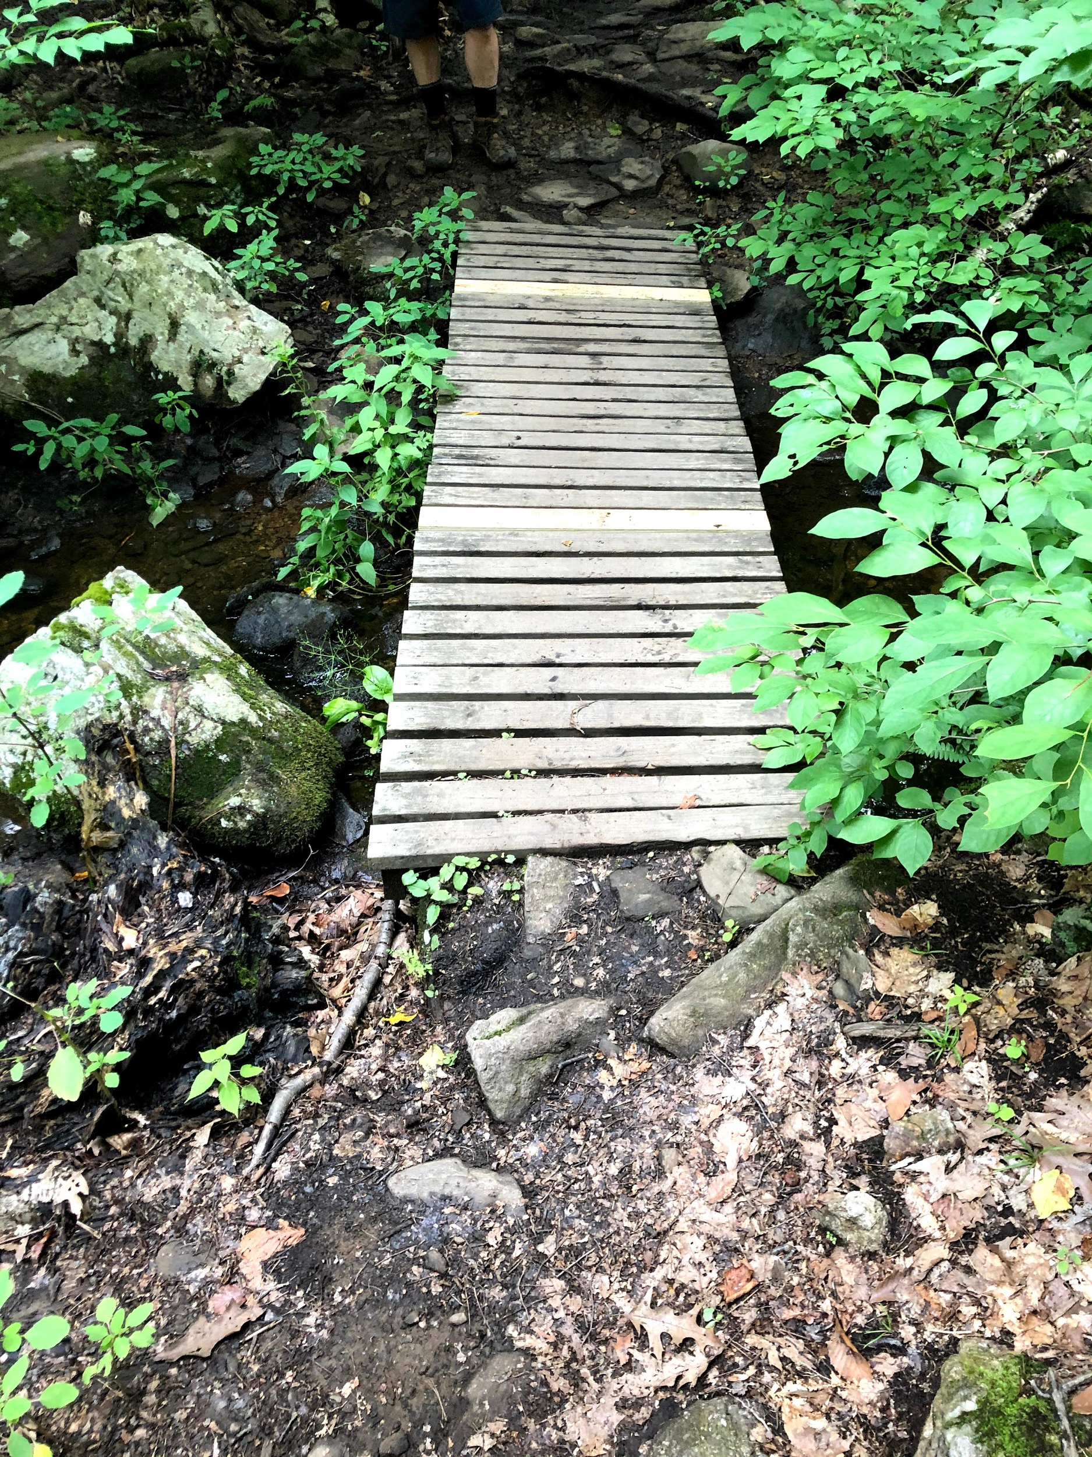
Current State
Bridge 1
(~13 ft)
Bridge 2
(~11 ft)

Slide 4
Benefits
New bridges would be sturdier
Less slip and wear, old bridges do not have method against slip on treads
Design (ramps, no rails) appeals to hikers and bikers as the trail is a popular spot

Slide 5
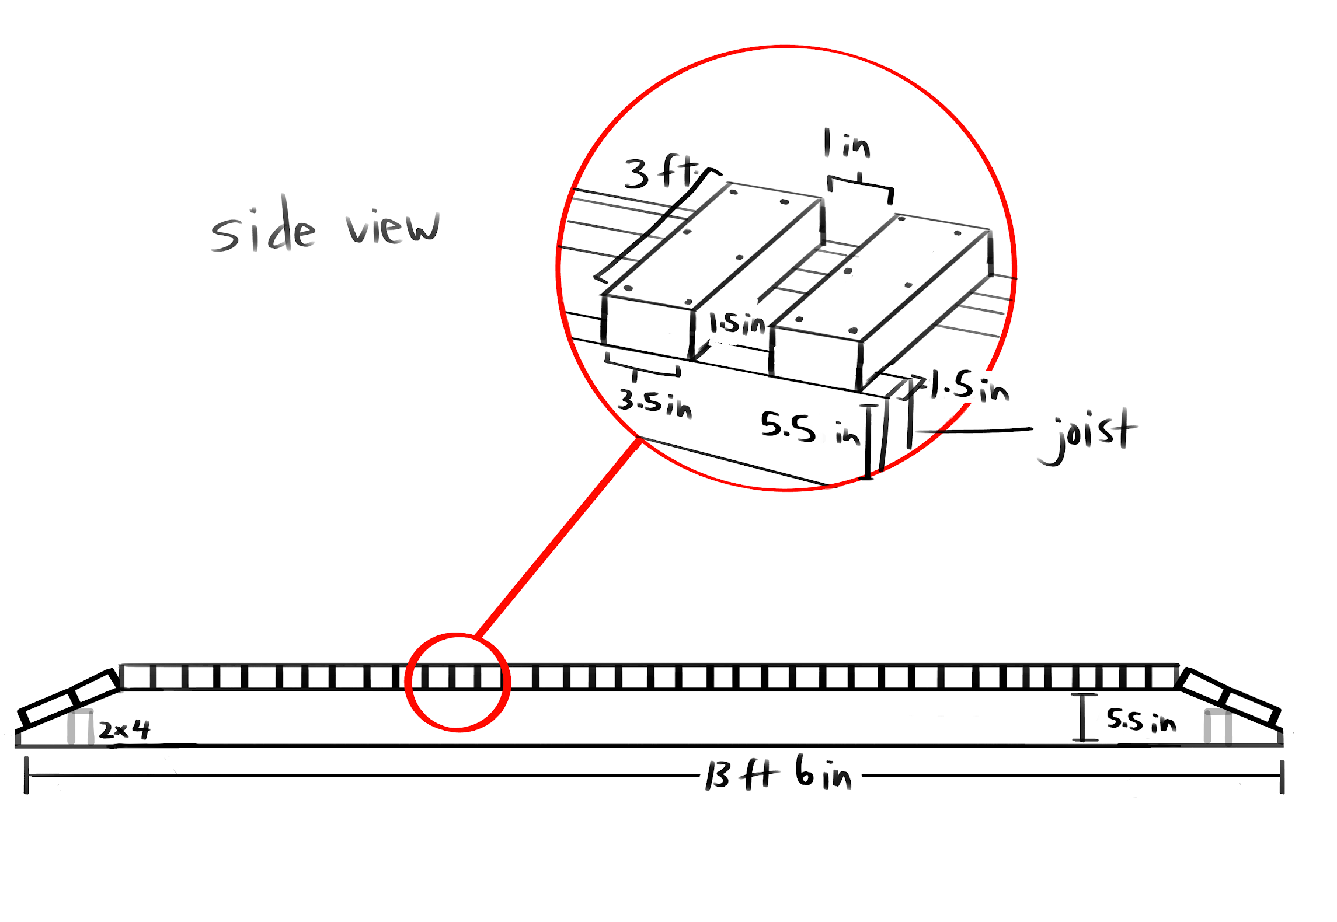
Bridge 1 Sketches
*drawings not to scale
36 treads

Slide 6
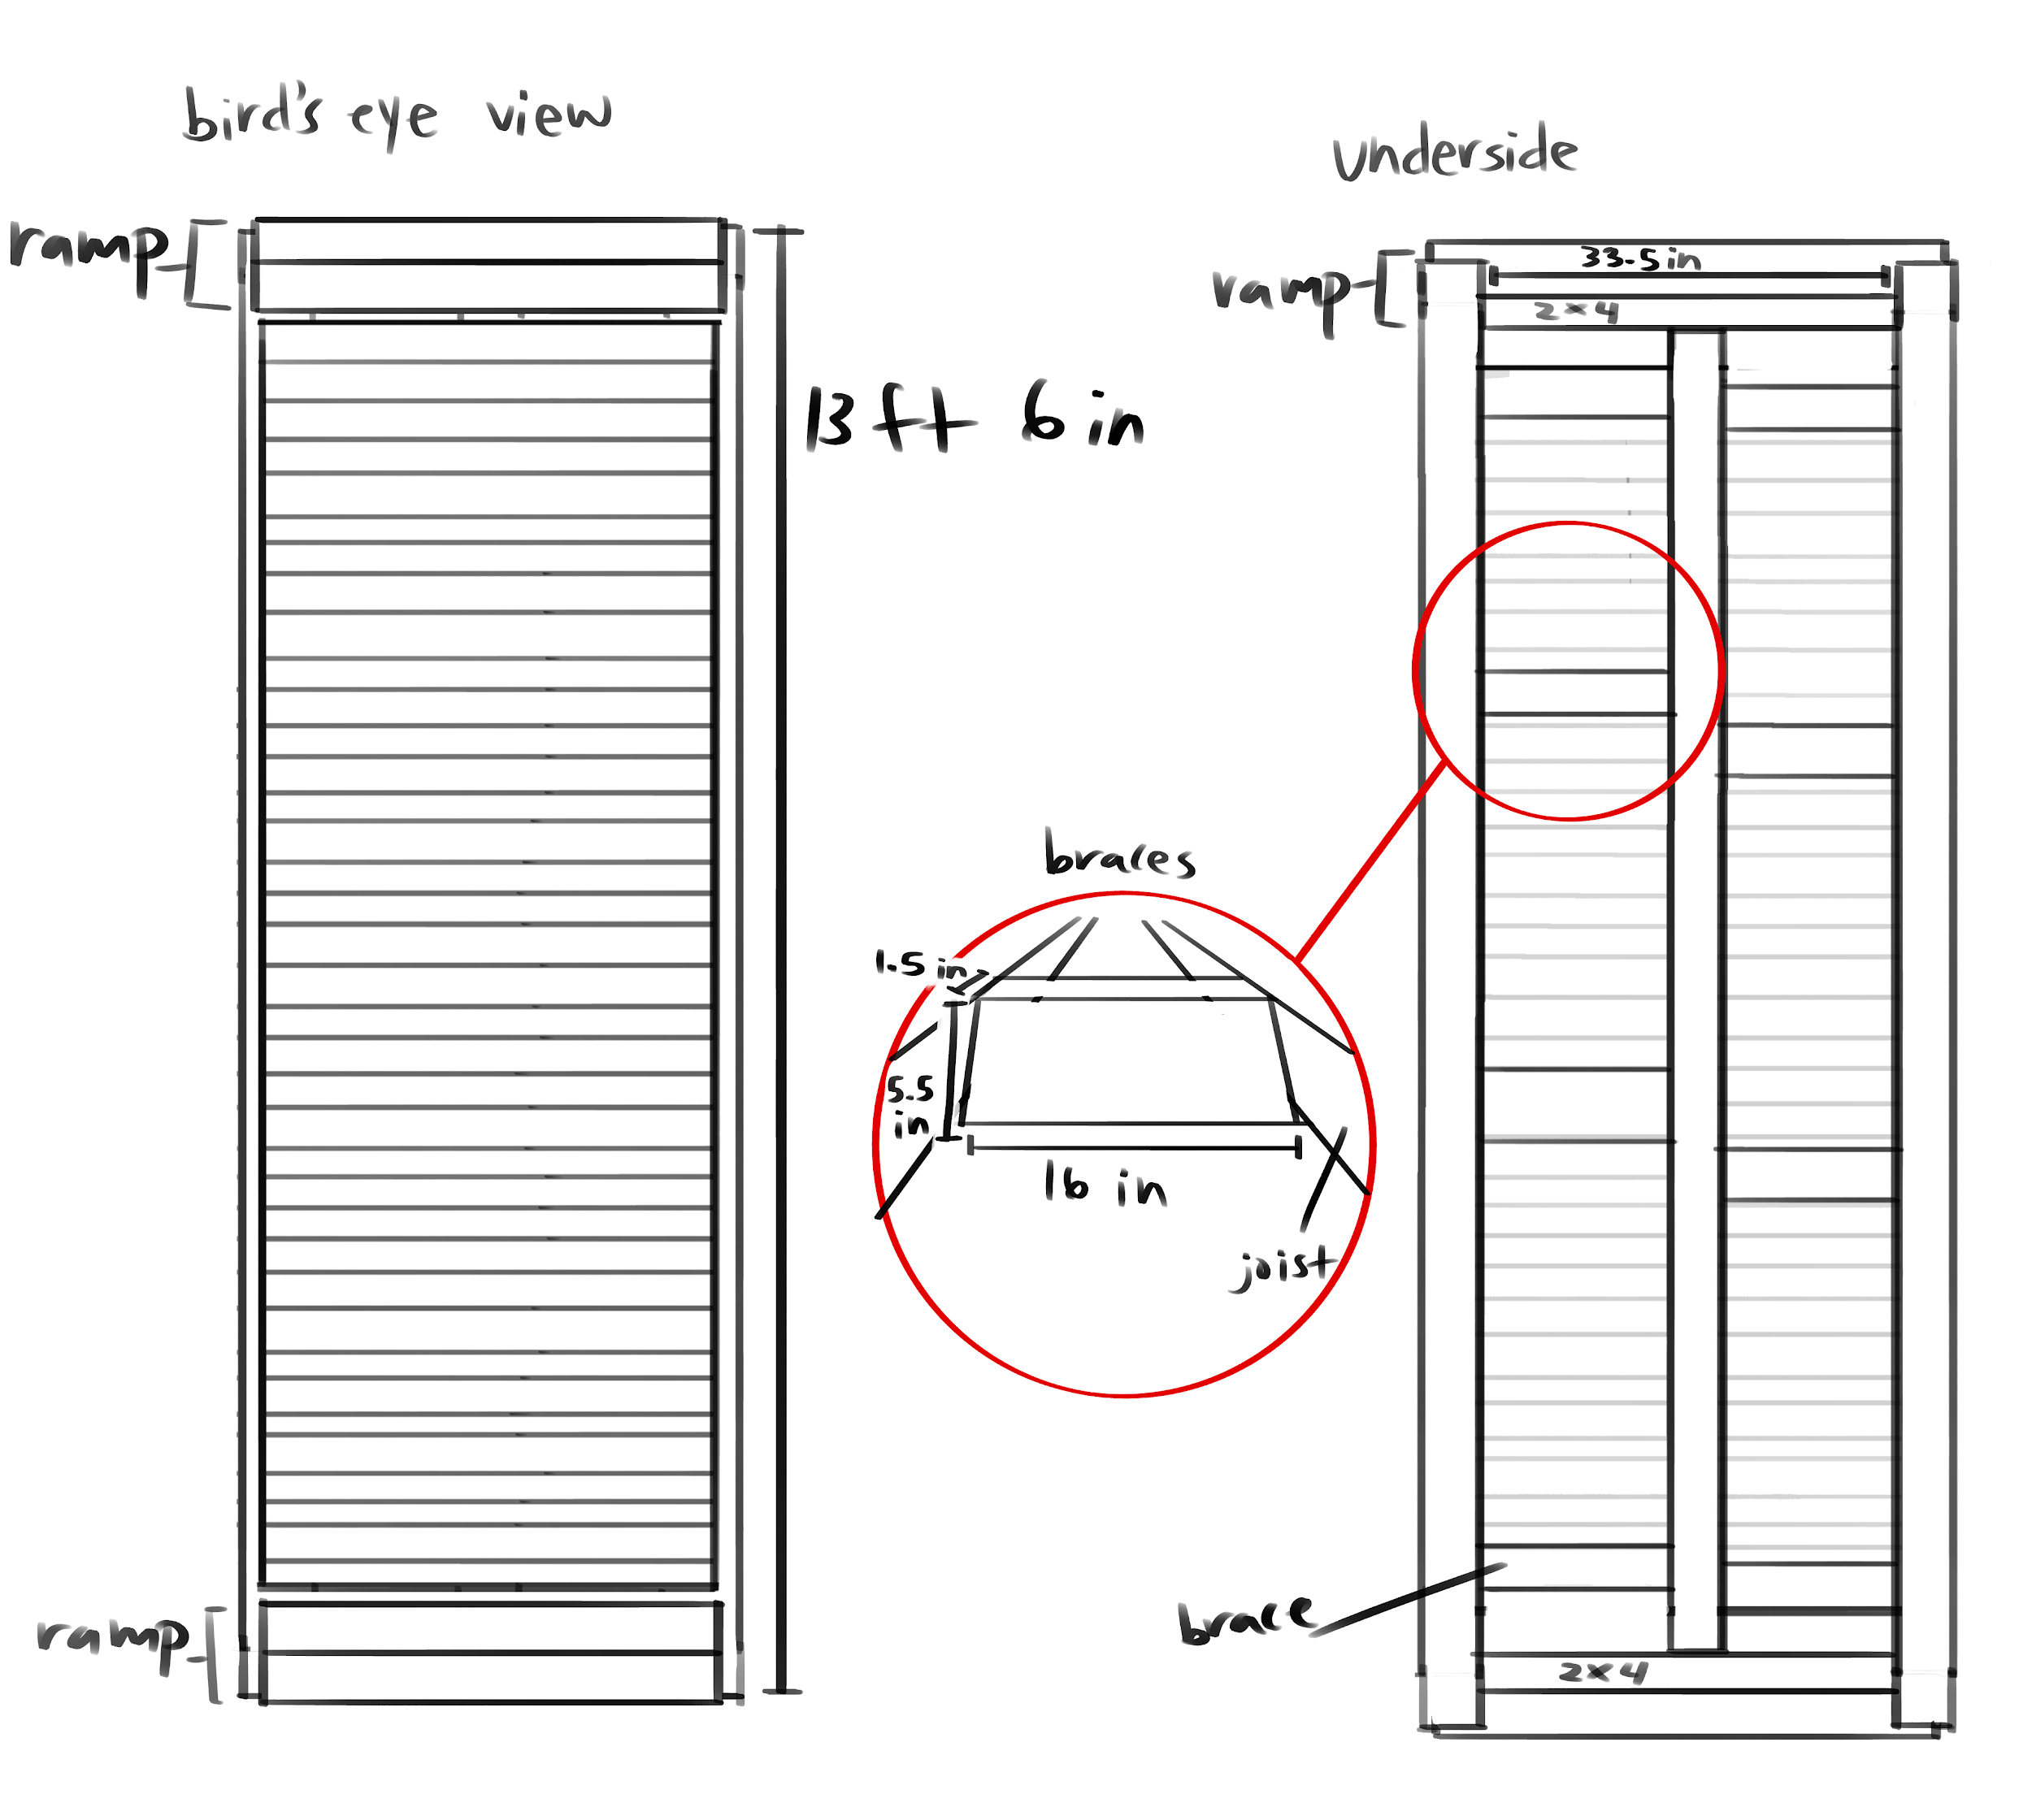
Bridge 1 Sketches
*drawings not to scale
36 treads
8 braces

Slide 7
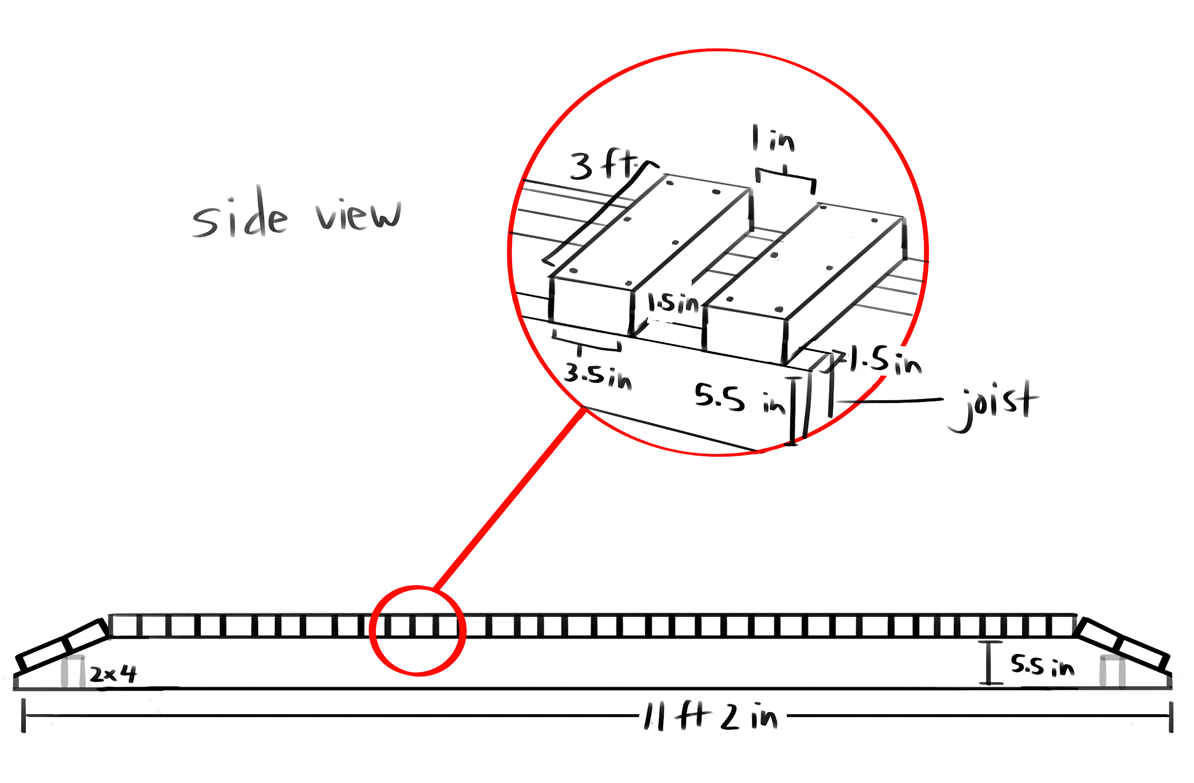
Bridge 2 Sketches
*drawings not to scale
30 treads

Slide 8
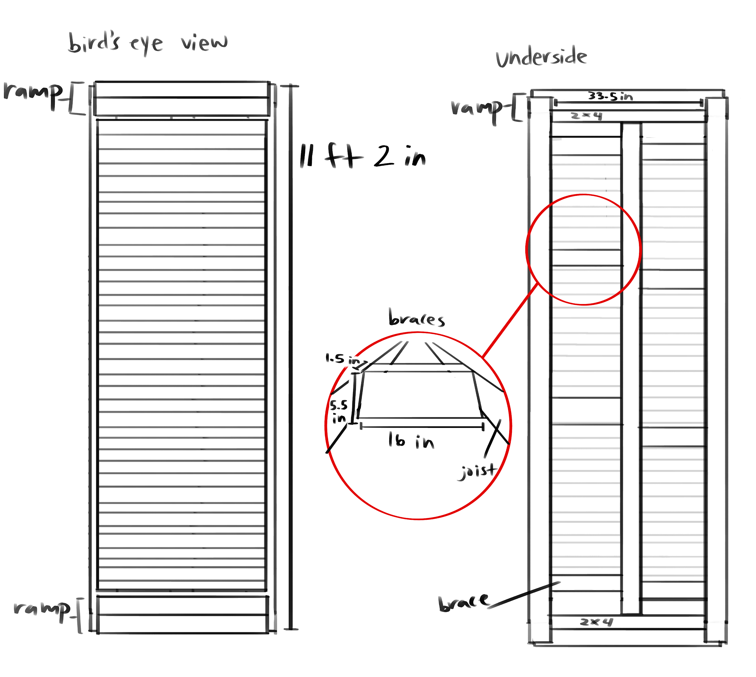
Bridge 2 Sketches
*drawings not to scale
30 treads
8 braces

Slide 9
Materials
2” x 6” x 12’ lumber ( 3 joists) → 1.5” x 5.5” x 11’2”
2” x 6” x 14’ lumber (3 joists) → 1.5” x 5.5” x 13’6”
2” x 4” x 10’ lumber (33) → 1.5” x 3.5” x 3’ (66 treads)
2” x 6” x 14’ lumber (16 braces) → 1.5” x 5.5” x 16”
Chicken wire
Two boxes of 3” screws (500 screws)
One box of 1 ¼ “ screws (200 screws)

Slide 10
Tools
Supplies
First aid kit
Water bottles/Cooler
Lunch/Snacks
Hand sanitizer
Face masks
Garbage bags
Work gloves
Safety goggles
Thermometer
Sunblock
Bug spray
Drill
Drill Bits
Chop Saw
Table Saw
Wheelbarrow
Shovel
(Not included in cost estimate, only required in Eagle Workbook.)

Slide 11
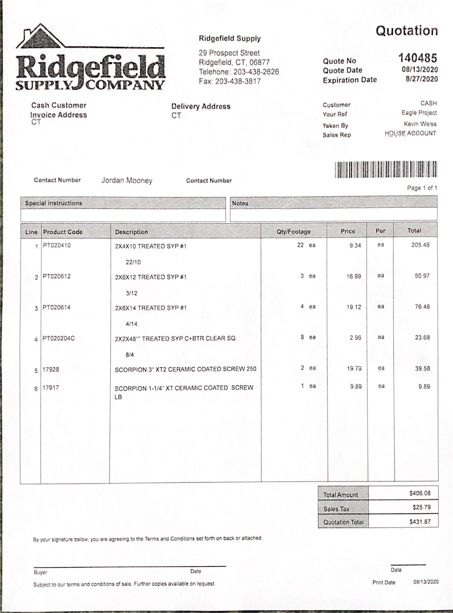
Quote from Ridgefield Supply
Cost of materials is about $431, some materials/measurements may change depending on availability
No philip head screws available
Timeline
Will split into two sessions, one for each bridge
I would like to start in September, specific date depending on what is in stock at Ridgefield Supply and when other leaders approve my proposal

Slide 12
Thank you for your time!

