Slide 1
Lucas Kaye Eagle Scout Project Boy Scout Troop 76

Slide 2
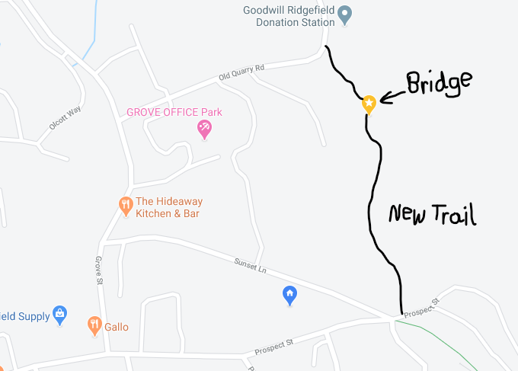
Location
New trail on former Schlumberger property
From the entrance on Prospect St, it is the 4th and last bridge project on the trail
Approximate location marked by star pin on map

Slide 3
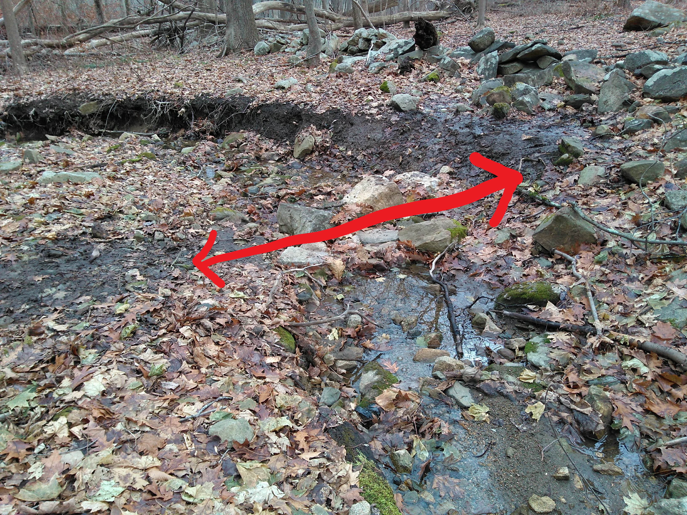
Wooden Footbridge Site
Bridge will be built over a stream
Arrow shows approximate length of bridge (14 ft)

Slide 4
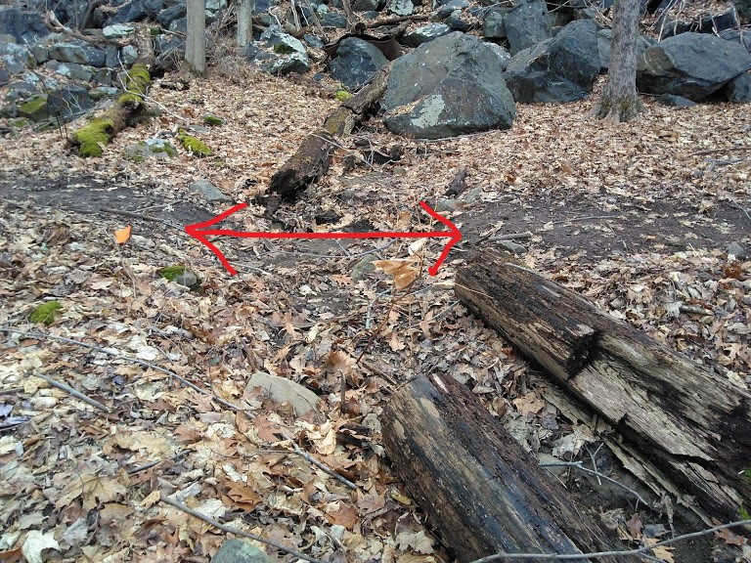
Rock Bridge Site
Small secondary bridge nearby made of rocks
Arrow shows approximate length of bridge (7 ft)

Slide 5
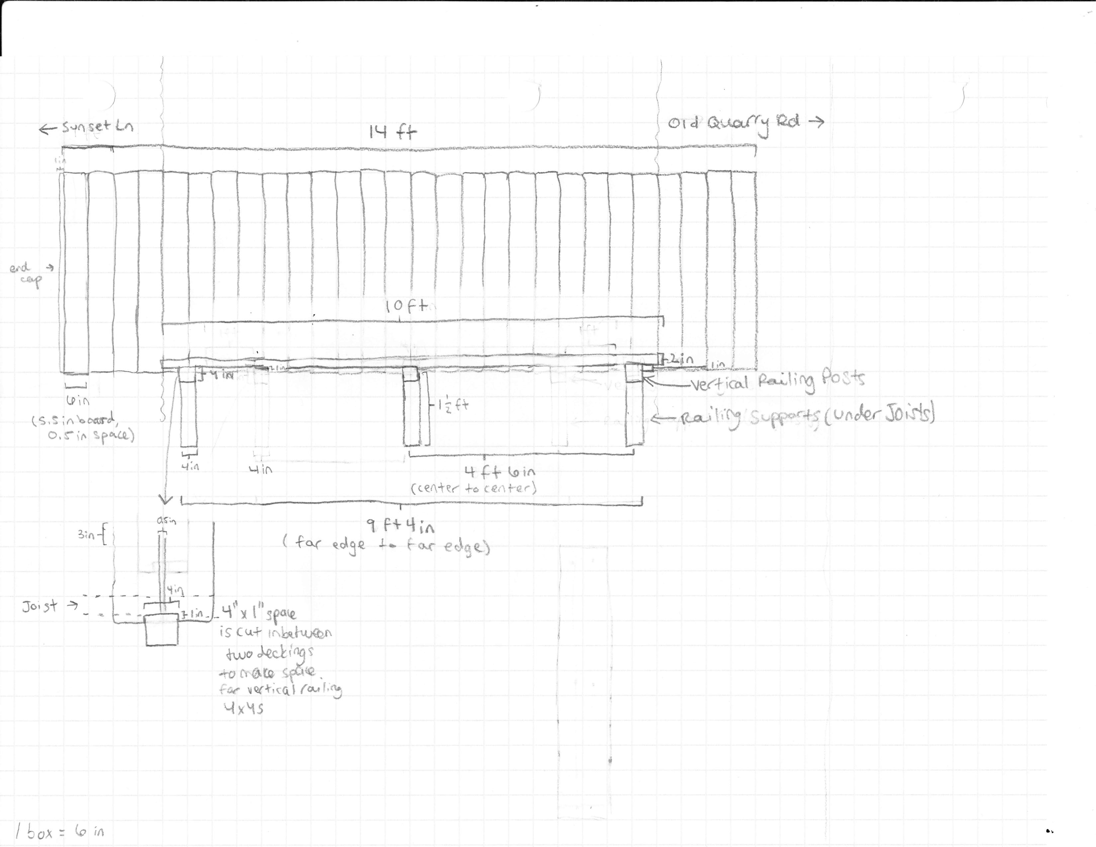
Wooden Bridge—Top View
Made of pressure treated lumber
Treads to increase traction

Slide 6
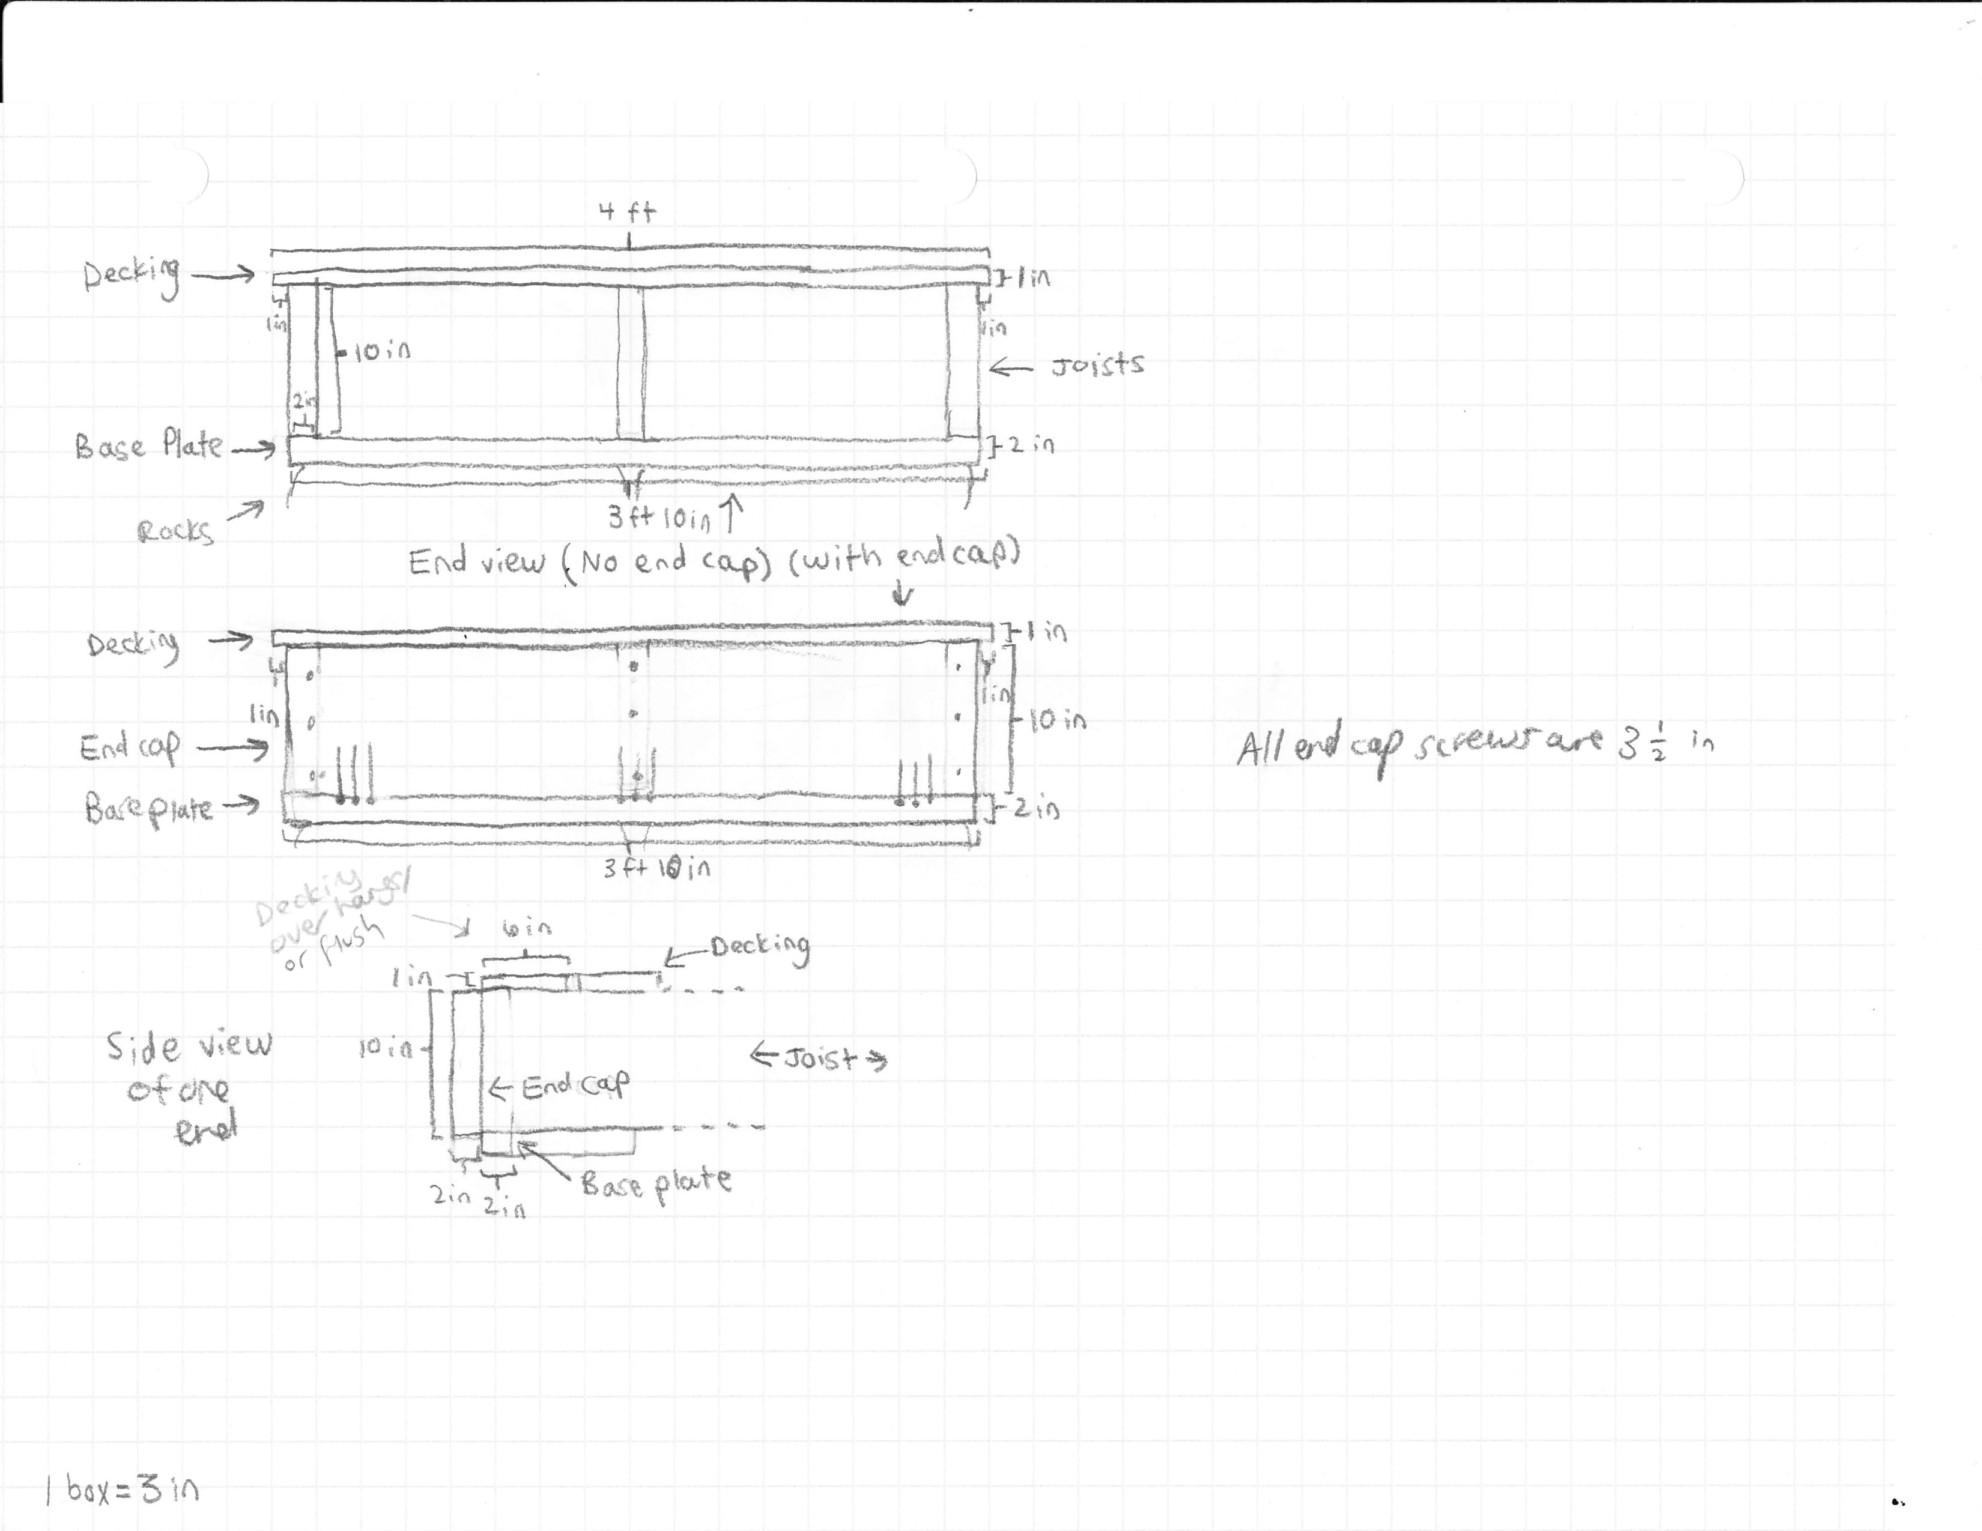
Wooden Bridge – End View

Slide 7
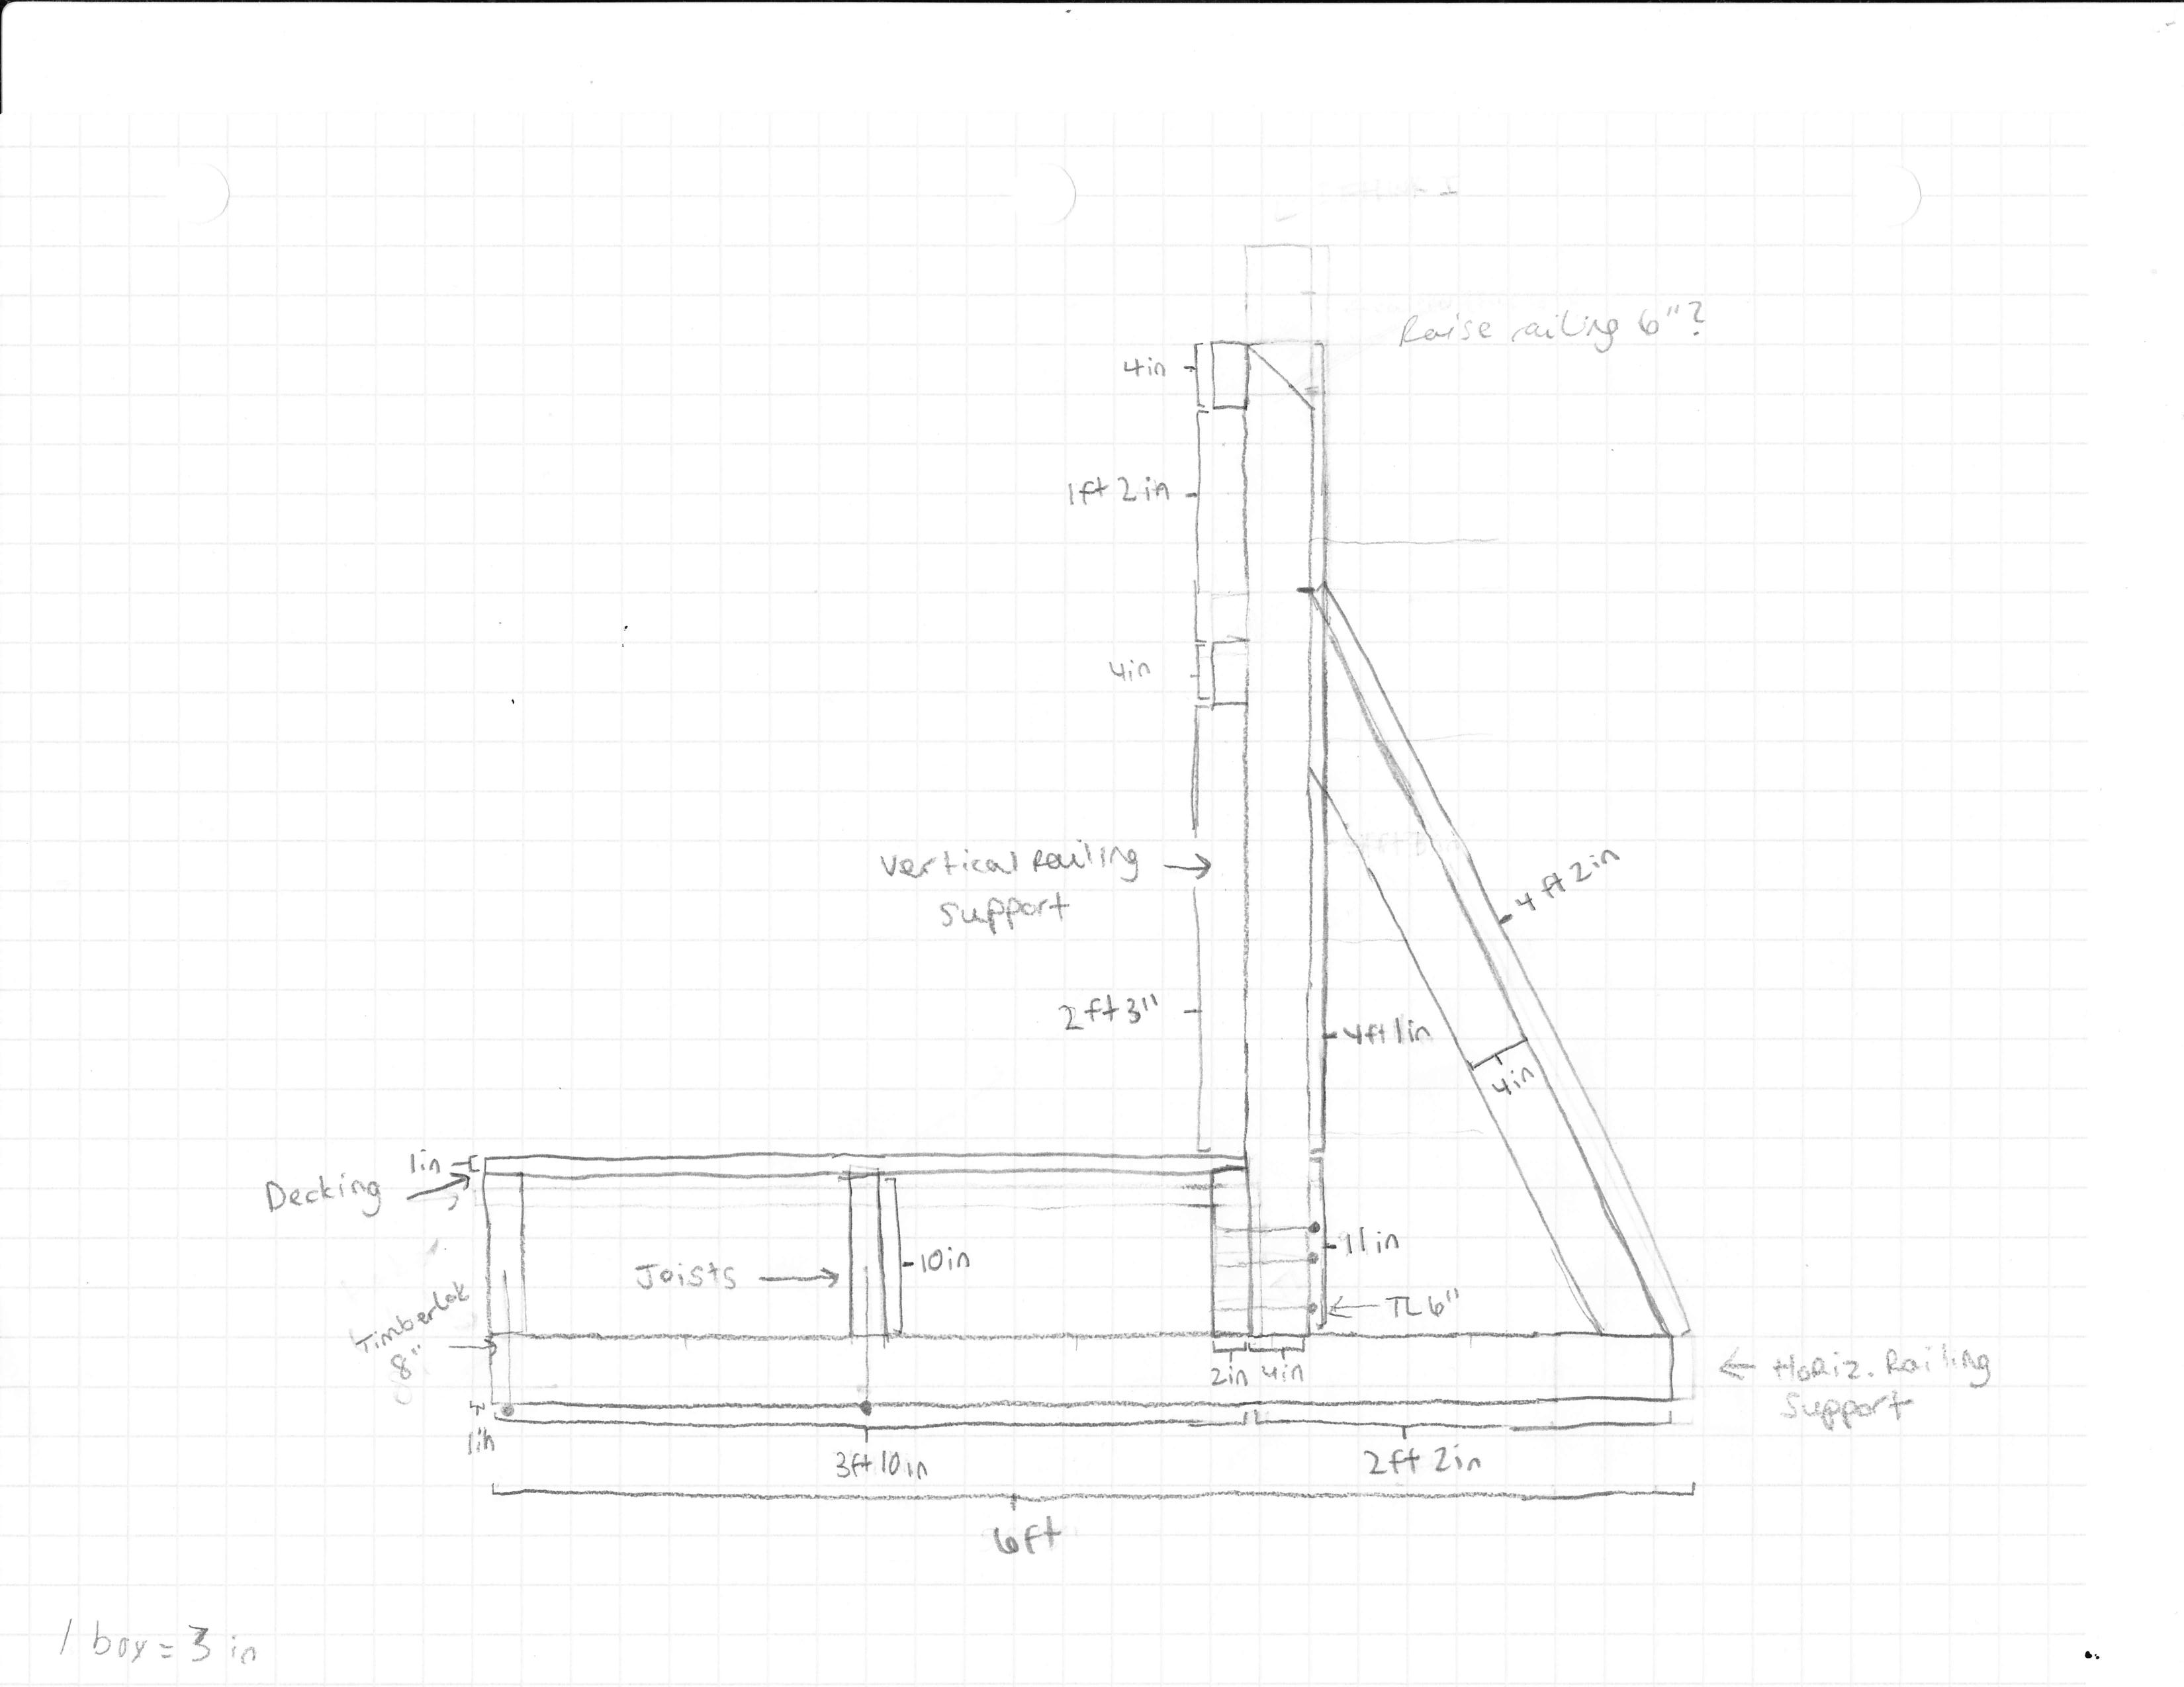
Wooden Bridge Railing – End View

Slide 8
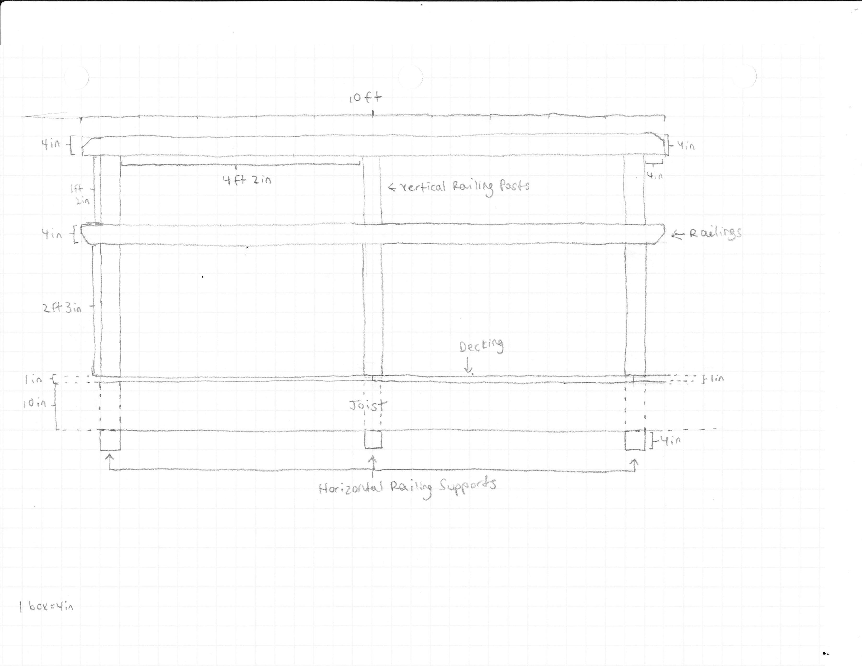
Wooden Bridge Railing – Side View

Slide 9
Cost of materials based on Ridgefield Supply estimate: $475.62
Time Frame for Construction: June or July

