Slide 1
Matthew Archer Eagle Scout Project Report

Slide 2
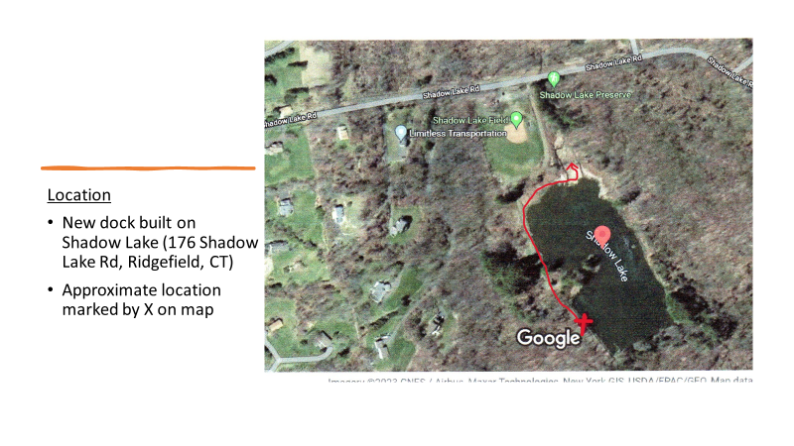
Location ofDock

Slide 3
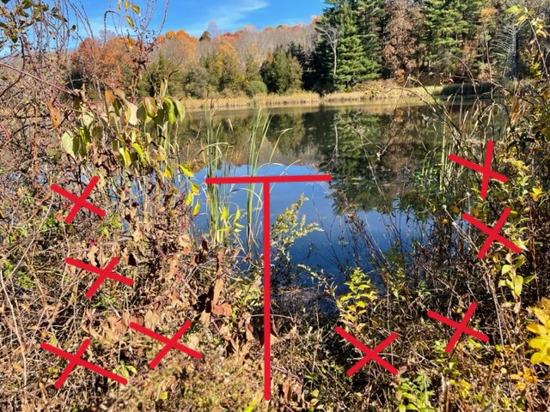
Dock Site
Red T shows approximate placement of dock
Red Xs show brush to be cleared.

Slide 4
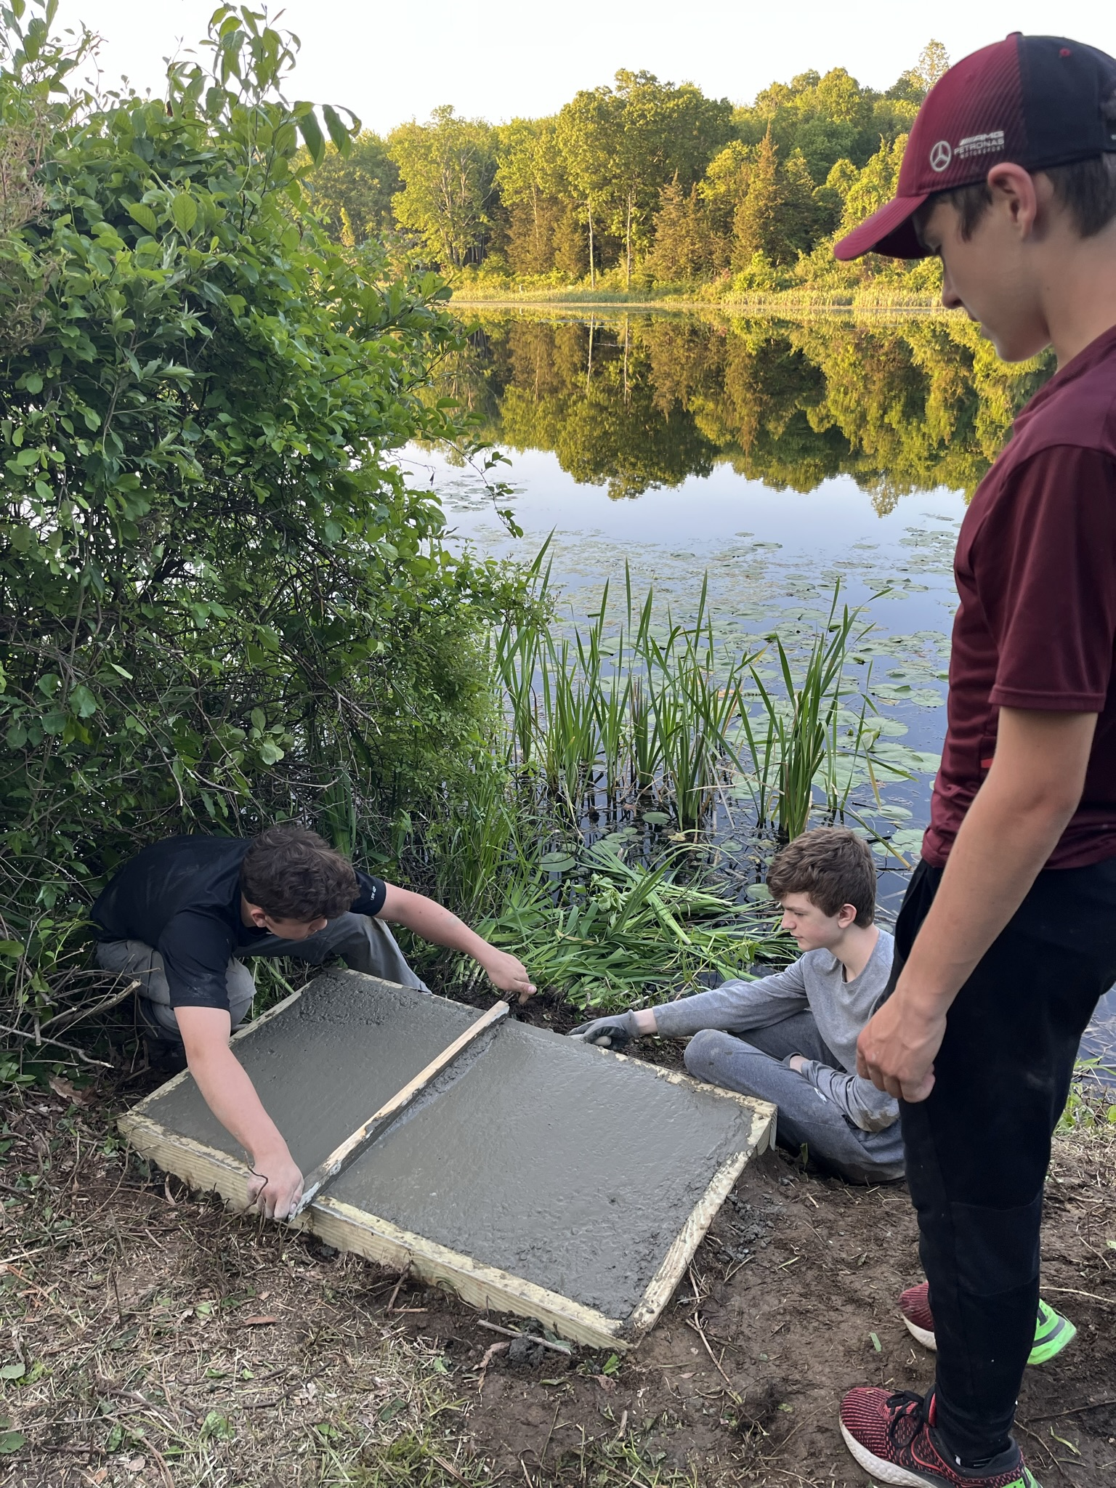
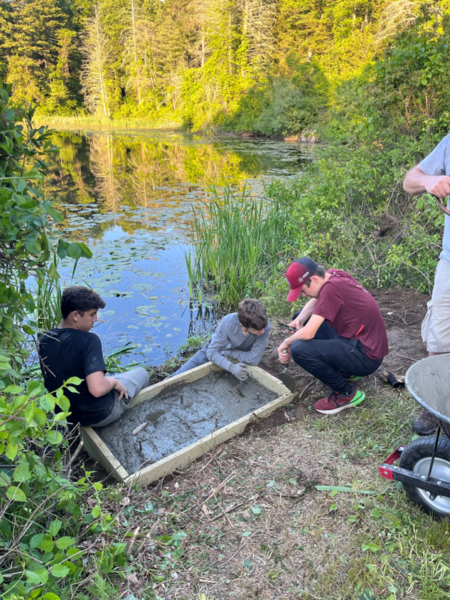
Slab Construction

Slide 5
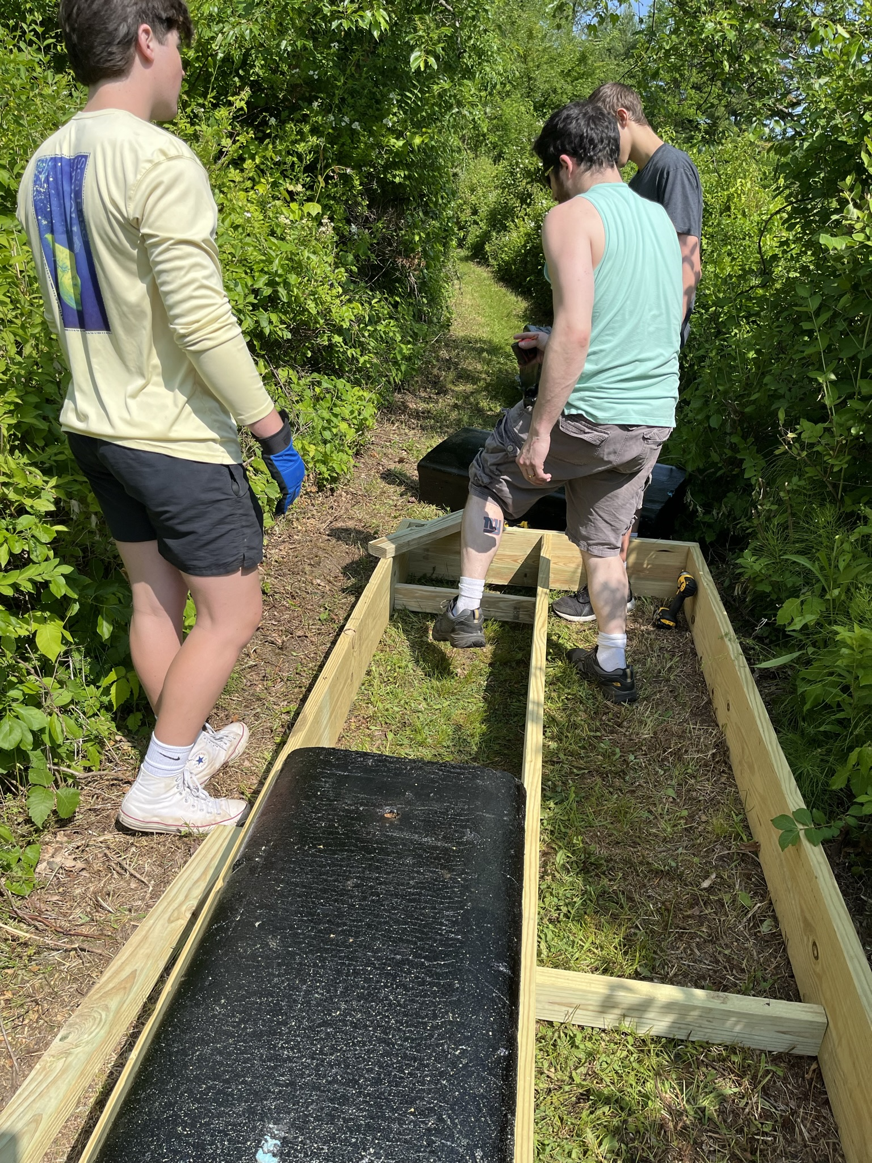
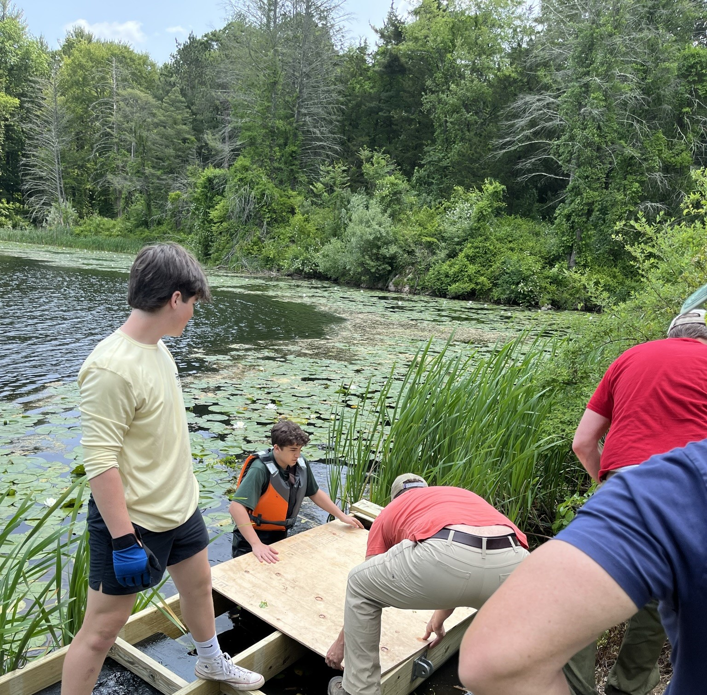
Dock Construction

Slide 6
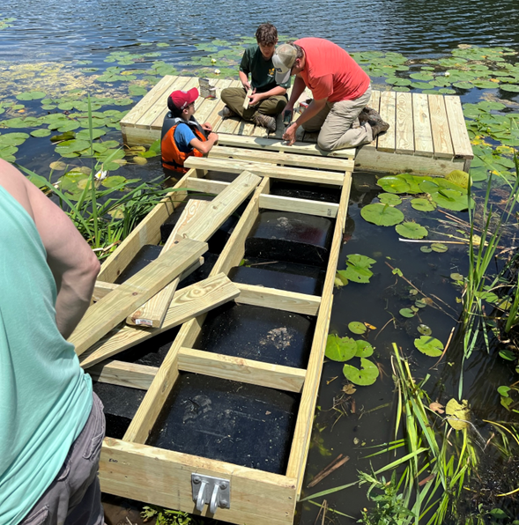
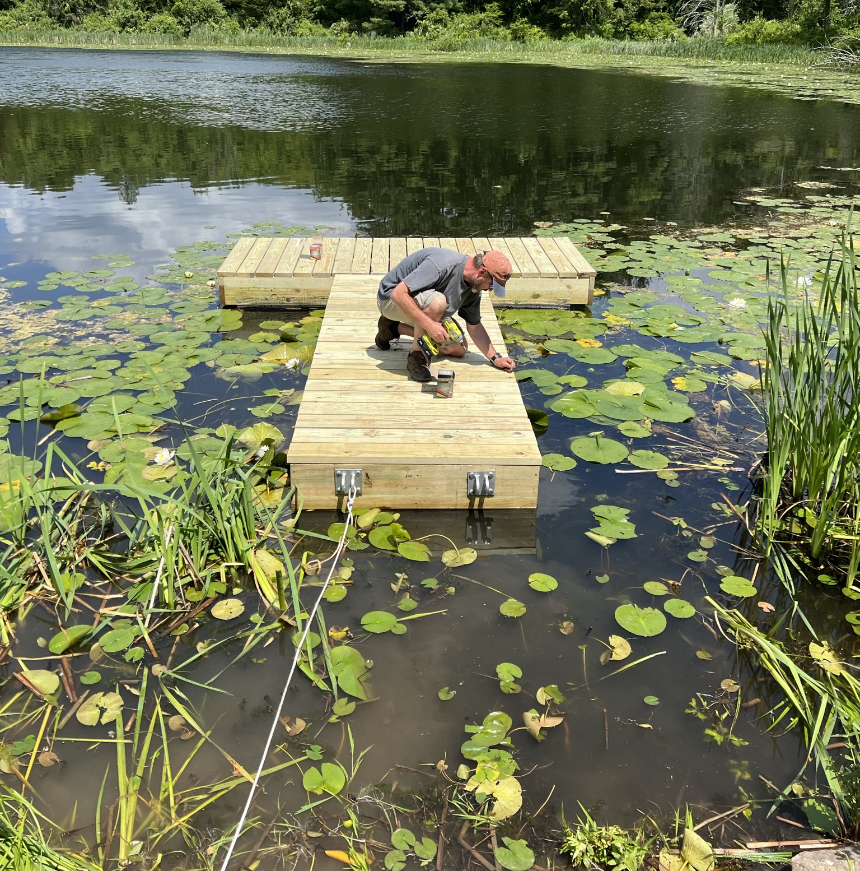

Slide 7
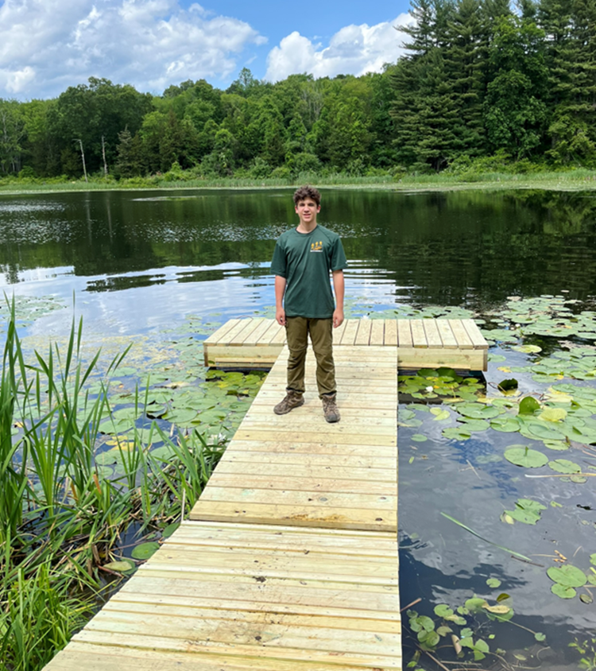
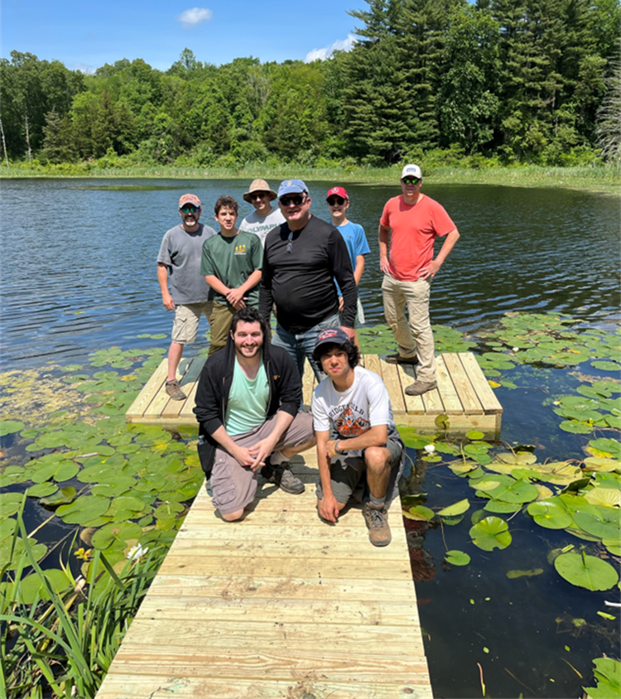
COMPLETED DOCK

Slide 8
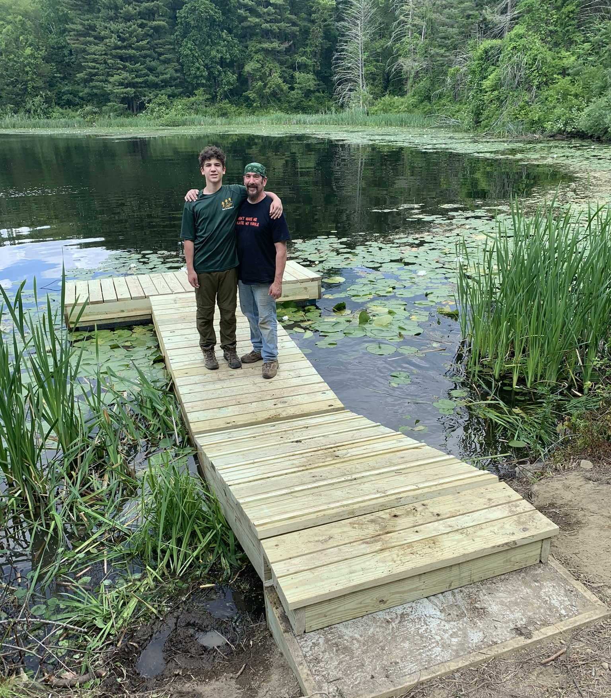
View of dock showing concrete slab and ramp.

Slide 9
Final Cost to the Conservation Commission
Approved for $1250.00
Final Cost: $1,080.11

Slide 10
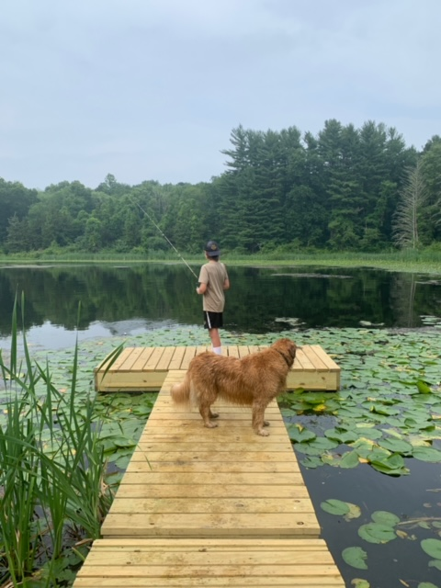
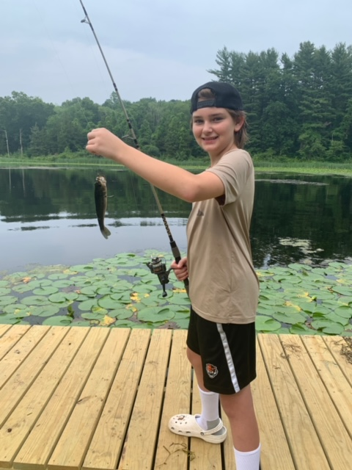
The dock is already being enjoyed giving Shadow Lake even more to offer.
THANK YOU to the Conservation Commission for your support!!
This project would not have been possible without you!

